Slide 1
This slide is a supplement to A Geography of Russia and Its Neighbors, Second Edition by Mikhail S. Blinnikov. Copyright © 2021 The Guilford Press.
Chapter 9. The Geopolitical Position of Russia in the World
“Geopolitics” may be defined as “the analysis of interactions between . . . geographic settings and . . . political processes” (Cohen, 2009, p. 5).
Heartland vs. Rimland theories of the 20th century
U.S.S.R. was an embodiment of the Heartland (Eurasia core) and one of two world superpowers, along with the USA for the second half of the 20th century
Russia is a successor state to the Soviet Union
half of the U.S.S.R.’s population
70% of its territory
Lost a lot of natural resources to other republics
Chromite and uranium ores in Kazakhstan
Manganese ore in Georgia
Coal and iron ore in Ukraine
Lost manufacturing plants in the Baltics, Belarus, and Ukraine
Lost a lot of political allies in the near and more distant abroad
E.g., former satellites in Europe, Asia and Africa
Some remain pragmatically engaged with Russia (Cuba, Angola, Vietnam)
A few are hostile (Poland is a good example)

Slide 2
This slide is a supplement to A Geography of Russia and Its Neighbors, Second Edition by Mikhail S. Blinnikov. Copyright © 2021 The Guilford Press.
Russia’s Neighbors
Table 9.1 illustrates the rankings of Russia vis-à-vis other nations in the world today.
Russia is located on the largest continent, Eurasia, with 15 direct neighbors
Immediate Neighbors (Tier I)
Norway, Finland, Estonia, Latvia, Lithuania, Poland, Belarus, Ukraine, Georgia, Azerbaijan, Kazakhstan, Mongolia, China, North Korea, Japan, and the United States (via Alaska).
Second-Degree Neighbors (Tier II)
Moldova, Armenia, Turkmenistan, Uzbekistan, Tajikistan, Kyrgyzstan, and Eastern European countries that were former socialist allies (Poland, Slovakia, Hungary, Czech Republic, Romania, Bulgaria, Serbia, Macedonia, and Montenegro).
More Distant Nations with Various Strong Ties to Russia (Tier III)
Other European Union countries, especially Germany and Cyprus;
Cuba, Nicaragua, and Venezuela in Latin America;
African countries with former socialist leanings (Ethiopia, Angola, Mozambique);
Asian countries (India, Vietnam, Laos, Thailand);
New trade partners (Turkey, South Korea, Taiwan);
Middle Eastern states (Israel, Syria, Iran, Iraq, United Arab Emirates, Egypt, Tunisia, Libya).

Slide 3
This slide is a supplement to A Geography of Russia and Its Neighbors, Second Edition by Mikhail S. Blinnikov. Copyright © 2021 The Guilford Press.
Other Countries (Tier IV)
The rest of the world: most of Latin America, Canada, most of Africa and the Middle East, and the rest of Asia and Oceania.
Is Russia Asian or European?
“Westernizers” and “Slavophiles” debates in the post-Napoleon 19th-century Russia.
Broadly, there are three main viewpoints in our times:
Russia forms a part of Western civilization and has been since at least the late 18th century. Its future will be more open and democratic and more like another European nation.
Russia is part of the East (Asia) more than of the West (Europe). It is prone to despotism and even absolutism, like some Asian monarchies of the past. It is also prone to theocratic rule by the church. Distrust of the West is ingrained in Russia.
Russia is neither part of the West nor part of the East, but is its own distinctly “Eurasian” civilization. This third viewpoint has been particularly popularized in the West by the late Samuel P. Huntington’s book (1996) The Clash of Civilizations and is favored by the current Russian power elite, as it allows them to steal from inside the country, while maintaining a Western standard of living and in fact spending most of their time outside of Russia in Europe.

Slide 4
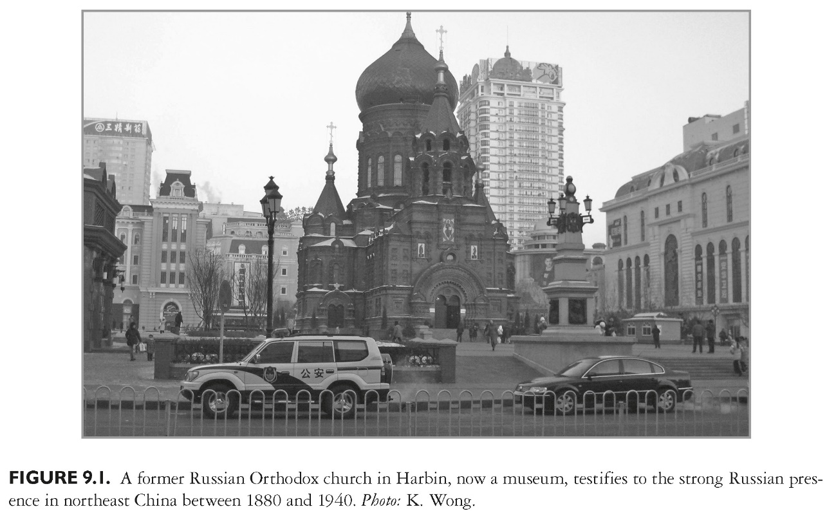
This slide is a supplement to A Geography of Russia and Its Neighbors, Second Edition by Mikhail S. Blinnikov. Copyright © 2021 The Guilford Press.

Slide 5
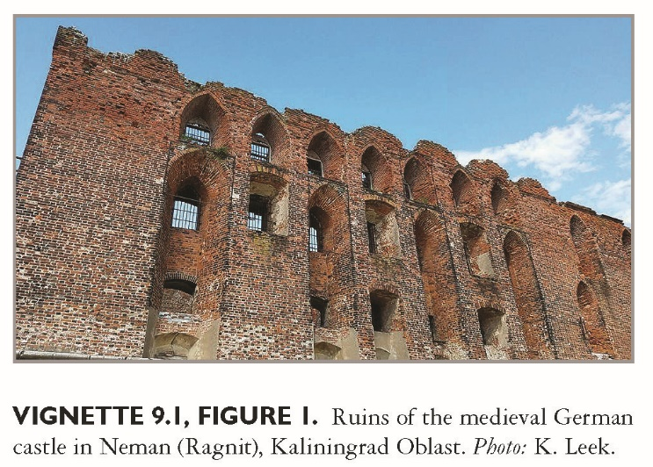
This slide is a supplement to A Geography of Russia and Its Neighbors, Second Edition by Mikhail S. Blinnikov. Copyright © 2021 The Guilford Press.

Slide 6
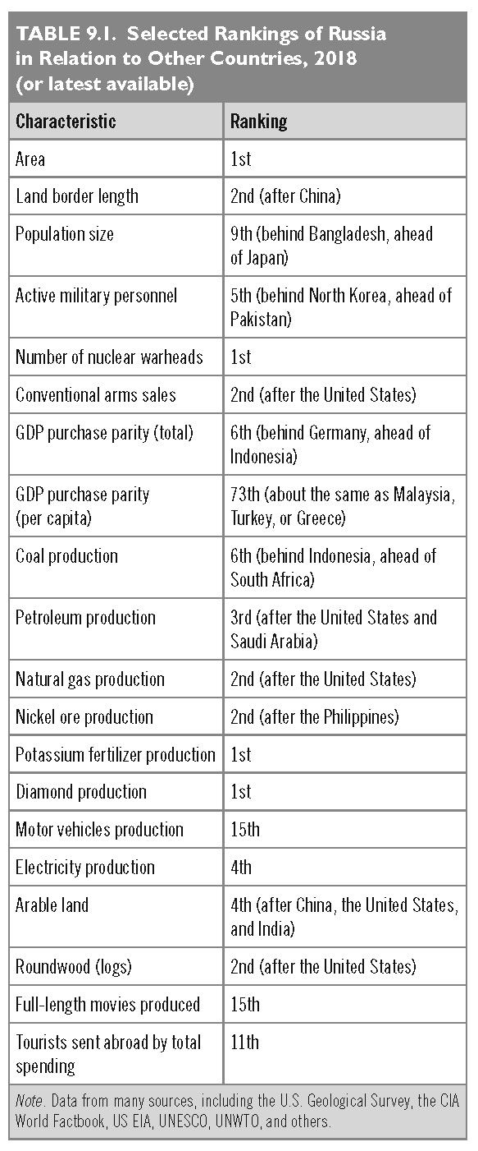
This slide is a supplement to A Geography of Russia and Its Neighbors, Second Edition by Mikhail S. Blinnikov. Copyright © 2021 The Guilford Press.

Slide 7
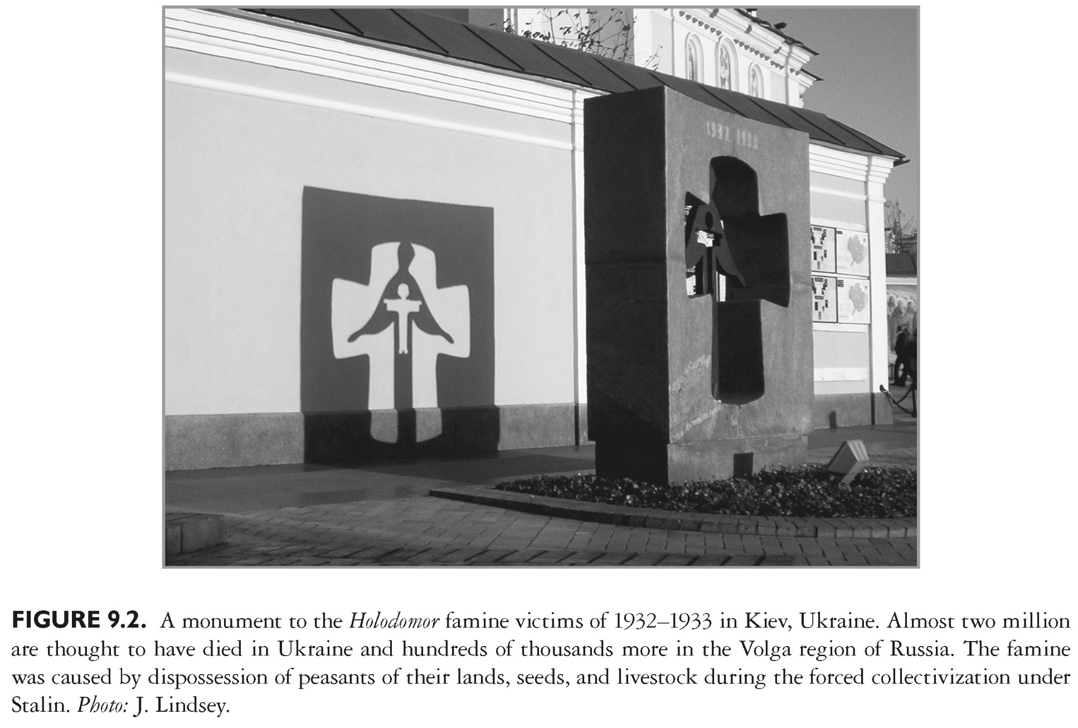
This slide is a supplement to A Geography of Russia and Its Neighbors, Second Edition by Mikhail S. Blinnikov. Copyright © 2021 The Guilford Press.

Slide 8
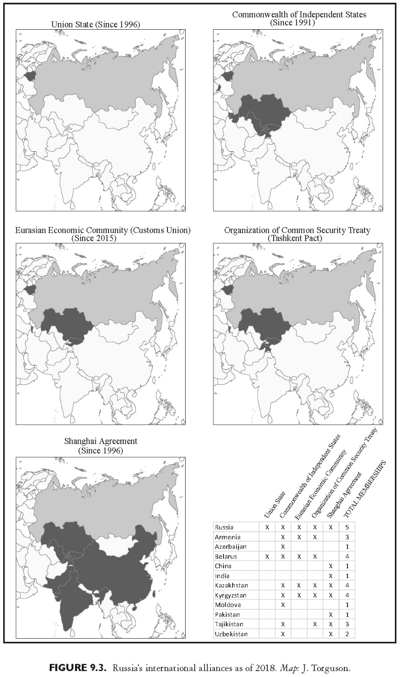
This slide is a supplement to A Geography of Russia and Its Neighbors, Second Edition by Mikhail S. Blinnikov. Copyright © 2021 The Guilford Press.

