Slide 1
This slide is a supplement to A Geography of Russia and Its Neighbors, Second Edition by Mikhail S. Blinnikov. Copyright © 2021 The Guilford Press.
Chapter 10. Demographics and Population Distribution
Historically: food was important, so heaviest concentration of people is found in areas with good farmland, e.g., Ukraine and southern European part of Russia along the Caucasus
Climate (not cold or dry)
Soil fertility (grassland soils are the best)
Rivers as transport and defense
Forests and hills as defense – Moscow site
So, most people would live along rivers, on high banks, in steppe or south taiga biome (where farming is possible) and in areas with warmer climate
As cities developed, some concentrations of people appear at mining and industrial sites, far away from good agricultural land

Slide 2
This slide is a supplement to A Geography of Russia and Its Neighbors, Second Edition by Mikhail S. Blinnikov. Copyright © 2021 The Guilford Press.
Population density map
Current population distribution is very uneven
Fertile wedge from Ukraine to South Siberia
Open W and S frontiers – many wars fought
Siberia settled by fur traders, Cossacks and monks
Peasants in 19th century
Labor camps and Komsomol projects in 20th century
Now many are leaving!
75% of people live on 25% in European Russia (115 million)
25% of people live on 75% in Siberia (25 million, most <200 km of Trans-Siberian railroad)
Russia is 74% urban (USA is 81%)
high rural density – Ukraine, Caucasus, wet parts of Central Asia (Fergana Valley)
West-East cross sections of population are instructive – almost nobody lives in the Far East (<5 million along the Pacific Rim compared to the West), compare to USA and Canada, where both coasts are well populated

Slide 3
This slide is a supplement to A Geography of Russia and Its Neighbors, Second Edition by Mikhail S. Blinnikov. Copyright © 2021 The Guilford Press.
Russian population in 2020
Goskomstat of Russia: 146.7 million, CIA: 142 million (why difference??)
CIA does not include 2.5 million in the Crimea, believing that to be still part of Ukraine
Also, CIA believes that a few 10,000s people per year in Russia die and are not correctly reported in the state statistics and a fair number of Russians no longer physically live in Russia, but are still counted as residents (e.g., this textbook author)
Population pyramid through time (visit census.gov and look in their International Database)
Seniors: 14%; older than USA, younger than EU
Total Fertility Rate: 1.6
Life expectancy: men 68, women 78 (among the highest discrepancies in the world)
2.7 is the average household size
Average marriage age is 29 for men, 25.5 for women
One in five lives alone
Two-thirds of Russian families have only one child, one quarter has two, and only 6% have 3 or more.
66% of children live with both parents
66% of people live in apartments
Why population loss? Overall, Russia loses between 200 and 300,000 people per year due to low birth rates, high death rates and emigration.

Slide 4
This slide is a supplement to A Geography of Russia and Its Neighbors, Second Edition by Mikhail S. Blinnikov. Copyright © 2021 The Guilford Press.
Russia loses people as a result of difference in birth and death rates
2020 Birth rate 10/1000
2020 Death rate 13/1000
Opposite of USA
Immigration +2/1000
Almost compensates, but dropped dramatically in 2020 due to pandemic
In US immigration +3/1000 and accounts for 1/3 of the growth rate of +0.9%
10 – 13 + 2 = –1/1000 or about 142,000 fewer people per year
Russia is 2nd in the world in total immigrants in the country and one of the top 4 countries producing emigrants (behind India, Mexico and China) – about 10.5 million left since 1991
Crisis in Ukraine: refugees from Donbass spilled into both Russia and central Ukraine

Slide 5
This slide is a supplement to A Geography of Russia and Its Neighbors, Second Edition by Mikhail S. Blinnikov. Copyright © 2021 The Guilford Press.
Russia’s population in the future, will be:
smaller
older
less Russian
better educated
healthier?
Must confront HIV/AIDS on top of endemic structural health problems
Should focus on health, education, and development of its youngest population
Causes and consequences of fertility decline in Russia
TFR=1.6, vs. 1.8 in USA, why?
Fertility decline caused by:
(i) greatly increased levels of contraceptive use and
(ii) continued high abortion rates

Slide 6
This slide is a supplement to A Geography of Russia and Its Neighbors, Second Edition by Mikhail S. Blinnikov. Copyright © 2021 The Guilford Press.
Abortions per 1000 women (2000–2003)
Spain 8
Finland 10
USA 12 (29 in 1981)
Hungary 22
Estonia 32
Russia 48
In 2004 for every 100 births there were 122 abortions
75% of women were married (or lived with a partner)
47% used contraception (68% in the USA)
Mortality rates & gender imbalance
Russian men live only 68 years on average, while women – 78. Why?
Some common mortality factors in Russia (pre-COVID 19 pandemic)

Slide 7
This slide is a supplement to A Geography of Russia and Its Neighbors, Second Edition by Mikhail S. Blinnikov. Copyright © 2021 The Guilford Press.
Most people die of illness common in old age
Cardiovascular
Cancer
Pulmonary
Urinary
Other
Middle-aged and younger (men), however, die mainly from
Accidents
Alcohol/drugs
Smoking
HIV/AIDS
Suicides
Predominant internal migration has been from Siberia to central Russia, a logical response to changing economic conditions
The town of Kadykchan, Magadan Oblast had 5794 in 1989; <875 in 2002…(photo)
Vorkuta lost half of its population since 1990 (it used to be a coal-mining town above the Arctic Circle in the European Russia) (photo)

Slide 8
This slide is a supplement to A Geography of Russia and Its Neighbors, Second Edition by Mikhail S. Blinnikov. Copyright © 2021 The Guilford Press.
Emigration from Russia in recent 30 years, in roughly descending order:
Germany
UK
Israel
USA
Czechia
Spain
Other EU countries
Canada
Australia
Thailand
Five waves: 1st right after 1917 revolution, 2nd after World War II, 3rd during the late Soviet period (mainly Jews and religious minorities were allowed to emigrate), 4th in the early 1990s during economic reforms and 5th since 2014
Typical emigrants of the recent period are young, well-educated, ambitious, above-average income, professionals or entrepreneurs, with passing knowledge of English and other world languages and many are in STEM and IT

Slide 9
This slide is a supplement to A Geography of Russia and Its Neighbors, Second Edition by Mikhail S. Blinnikov. Copyright © 2021 The Guilford Press.
Some are political refugees from the Putin’s regime, but most are simply looking for better economic options
Coney Island, Brooklyn, NY neighborhood – the highest concentration of ex-Soviet, mainly Russian-speaking immigrants in the USA

Slide 10
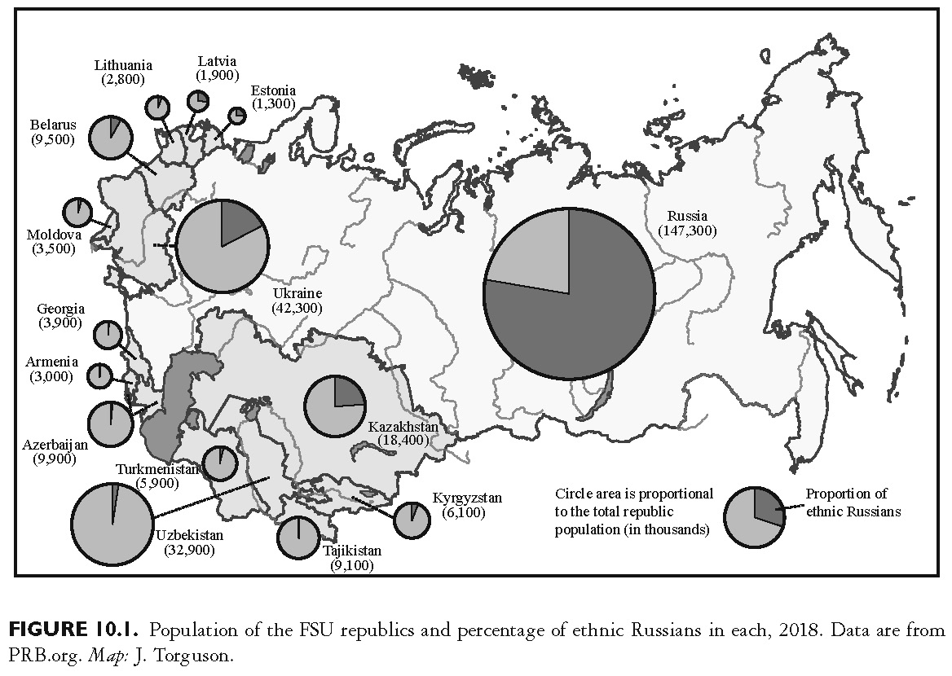
This slide is a supplement to A Geography of Russia and Its Neighbors, Second Edition by Mikhail S. Blinnikov. Copyright © 2021 The Guilford Press.

Slide 11
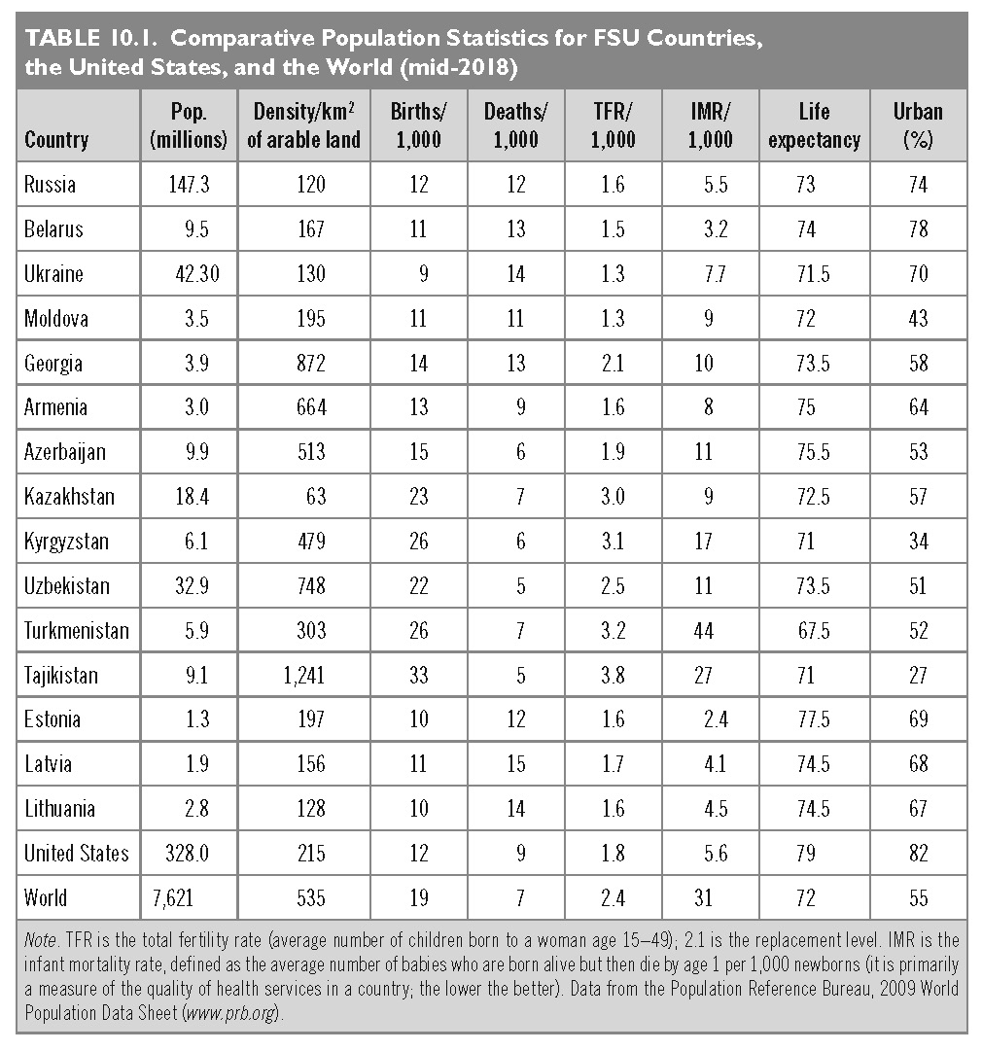
This slide is a supplement to A Geography of Russia and Its Neighbors, Second Edition by Mikhail S. Blinnikov. Copyright © 2021 The Guilford Press.

Slide 12
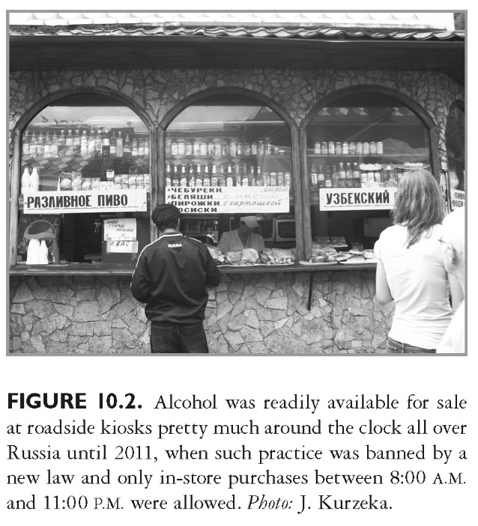
This slide is a supplement to A Geography of Russia and Its Neighbors, Second Edition by Mikhail S. Blinnikov. Copyright © 2021 The Guilford Press.

Slide 13
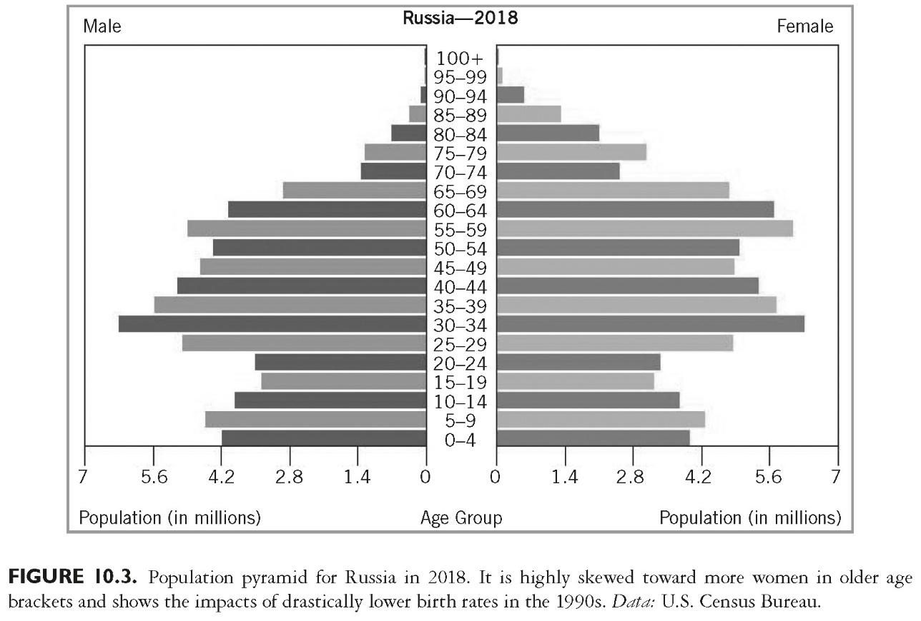
This slide is a supplement to A Geography of Russia and Its Neighbors, Second Edition by Mikhail S. Blinnikov. Copyright © 2021 The Guilford Press.

Slide 14
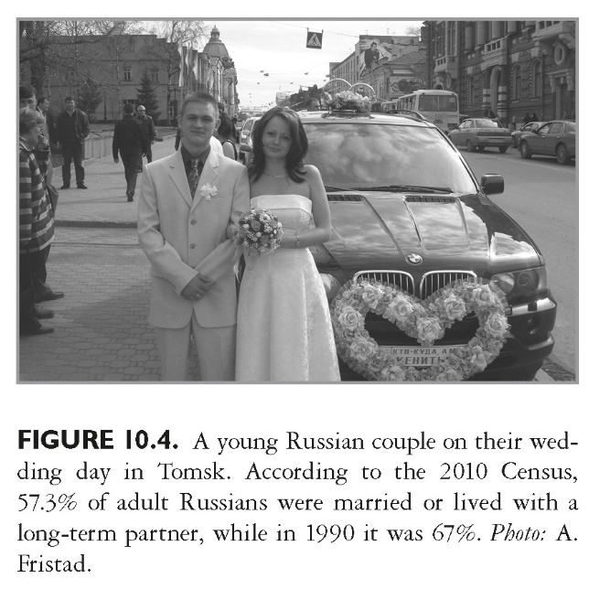
This slide is a supplement to A Geography of Russia and Its Neighbors, Second Edition by Mikhail S. Blinnikov. Copyright © 2021 The Guilford Press.

Slide 15
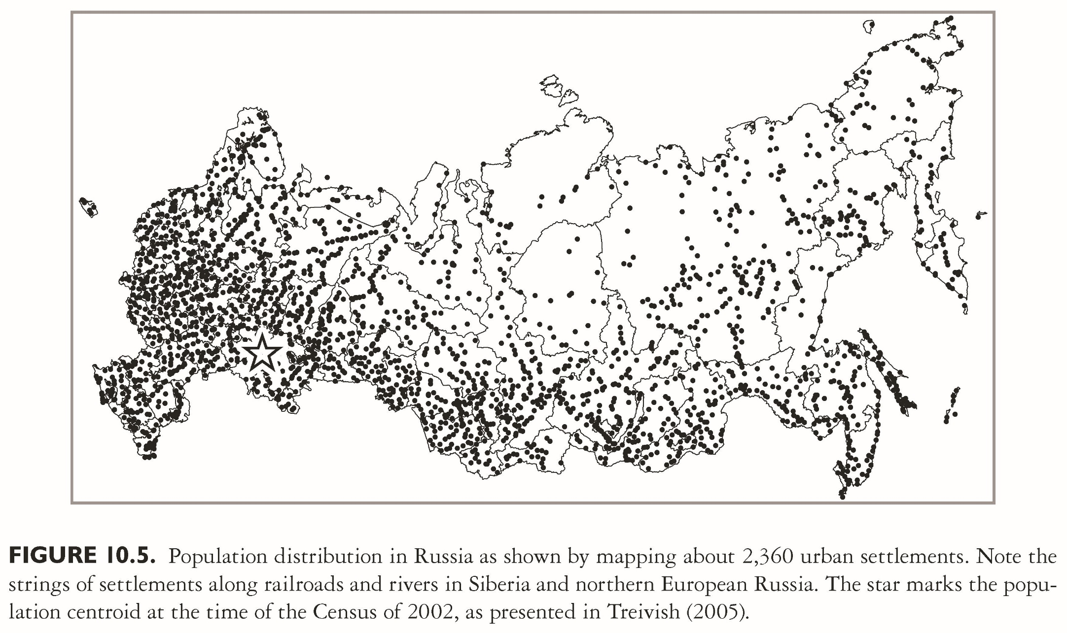
This slide is a supplement to A Geography of Russia and Its Neighbors, Second Edition by Mikhail S. Blinnikov. Copyright © 2021 The Guilford Press.

