Slide 1
This slide is a supplement to A Geography of Russia and Its Neighbors, Second Edition by Mikhail S. Blinnikov. Copyright © 2021 The Guilford Press.
Chapter 13. Culture and Languages
Race
Indo-European (Caucasian) vs. Mongolian (Asian) race
Languages – >160 in Russia alone!
Slavic (Indo-European), Turkic (Altaic), Finno-Ugric (Uralic)
Religion
Orthodox Christianity vs. Islam + some others, most notably Buddhism, Judaism, Roman Catholic, Protestant churches; atheistic regime under Communism discouraged practices
Diet, dress, music, architecture, social customs
Interactions during the long history together
All impacted by 70 years under Communism
Diverging now
FSU major nationalities (free online map)
https://legacy.lib.utexas.edu/maps/commonwealth/ussr_nat_82.jpg

Slide 2
This slide is a supplement to A Geography of Russia and Its Neighbors, Second Edition by Mikhail S. Blinnikov. Copyright © 2021 The Guilford Press.
What makes an ethnic group?
Ethnic group ≠ nation! (Examples: Walloons in Belgium are ethnic group that speaks French, but they are still considering themselves Belgian nationals)
Ethnos (Gr.) = Folk (En.)= People (Lat.)= народ (Рус.)
Shared origin, language, self-perception
Natural origin or social construct?
Shared myth about the origin is very important as it justifies and perpetrates the existing power structures and territorial claims
Supposed baptism of Prince Vladimir in the Crimea 1000 years ago was used by the Kremlin as justification for Russia’s annexation of the Crimea in 2014
Ethnic ties are expressed in customs and are used to justify political conquest and distribution of power and wealth

Slide 3
This slide is a supplement to A Geography of Russia and Its Neighbors, Second Edition by Mikhail S. Blinnikov. Copyright © 2021 The Guilford Press.
Major peoples in the region today (language-based)
Indo-European Family
Slavs (Russians ~115 m, Ukrainians, Belorussians)
Balts (Lithuanians & Latvians)
Persian (Tajiks)
Armenians, Roma, Germans, Greeks
Altaic Family, especially Turkic branch
Tatars, Bashkirs, Chuvash, Yakuts, Kazakhs, Kyrgyz, Azeris, Turkmens, Uzbeks, Altays, Tuvins
Mongolians are in their own branch (Buryats & Kalmyks)
Evenks & Tungus are also in the family, but even more distinct
Uralic/Finno-Ugric (Estonians, Karelians, Mordva, Mari, Komi, Khanty, Udmurt, Mansi, Nenets)
Caucasian (Georgians, Chechens, Dagestanis, Cherkesy)
Semitic (Jews)
Paleosiberians (Chukchi & Koryaks) and Inuit/Aleut
Others, of poorly understood origins – Kets and Nivkhs

Slide 4
This slide is a supplement to A Geography of Russia and Its Neighbors, Second Edition by Mikhail S. Blinnikov. Copyright © 2021 The Guilford Press.
Russian Empire
Russian Empire was an absolute monarchy
One sovereign tsar-emperor ruled millions of subjects
Ethnicity mattered little, as long as one was loyal
Empires have fluid borders and are usually expansionist
Ethnic Russians made up ~40–50%
No special rights given to any ethnicity, although some discrimination existed (e.g., Roma, Jews, tribes of the North were not favored and sometimes persecuted)
Special arrangements with Poland, Finland, Khivy, and some other units in Central Asia, and with the frontier dwelling Cossacks (a mixed ethnic group of both Slavic and Turkic origins)
Distinction was mostly religion-based (Orthodox, Muslim, Jewish, “Pagan”) and place-based
USSR – multinational state:
Lenin and Stalin had different ideas about how to rule them

Slide 5
This slide is a supplement to A Geography of Russia and Its Neighbors, Second Edition by Mikhail S. Blinnikov. Copyright © 2021 The Guilford Press.
Top six nationalities (by numbers in 1990)
Russians 140 million
Ukrainians 42 million
Uzbeks 14 million
Belorussians 9 million
Kazakhs 7 million
Tatars 6 million
Out of the total population of ~270 million, >150 nationalities
15 were recognized as “Soviet republics”
~25 – autonomous republics within some of those

Slide 6
This slide is a supplement to A Geography of Russia and Its Neighbors, Second Edition by Mikhail S. Blinnikov. Copyright © 2021 The Guilford Press.
Table 10.2: in Russia
Ethnicity | Thousands | Share 2002 | Share 2010 | Where live
Russian | 115,889 | 79.8% | 80.9% | Everywhere
Tatar | 5,555 | 3.8% | 3.9% | Tatarstan, Bashkortostan, Moscow
Ukrainian | 2,943 | 2% | 1.4% | South of European Part, Siberia
Bashkir | 1,673 | 1.2% | 1.5% | Bashkortostan
Chuvash | 1,637 | 1.1% | 1.05% | Chuvash Republic (Volga)
Chechen | 1,360 | 0.9% | 1.04% | Chechnya, Moscow
Armenian | 1,130 | 0.8% | 1.86% | Moscow and other big cities
Mordva | 843 | 0.6% | 0.54% | Mordovia Republic (Volga)
Avar | 815 | 0.6% | 0.66% | Dagestan Republic (Caucasus)
Belorussian | 808 | 0.6% | 0.38% | Moscow, western European part
Kazakh | 654 | 0.45% | 0.47% | South-central Siberia
Udmurt | 637 | 0.44% | 0.40% | Udmurtiya Republic (Volga)
Azeri | 622 | 0.43% | 0.44% | Moscow, Dagestan Republic
Mari | 604 | 0.42% | 0.4% | Mari-El Republic (Volga)
German | 597 | 0.41% | 0.29% | Volga, Altaysky Kray
Kabarda | 520 | 0.36% | 0.38% | Kabardino-Balkaria (Caucasus)
Ossetin | 515 | 0.35% | 0.39% | North Ossetia-Alania (Caucasus)
Dargin | 510 | 0.35% | 0.43% | Dagestan Republic (Caucasus)
Buryat | 445 | 0.31% | 0.34% | Buryat Republic (East Siberia)
Yakut | 444 | 0.31 | 0.35% | Sakha-Yakutia (East Siberia)

Slide 7
This slide is a supplement to A Geography of Russia and Its Neighbors, Second Edition by Mikhail S. Blinnikov. Copyright © 2021 The Guilford Press.
Understanding differences among various groups
Well-established minorities with their own autonomous republics (Chechens, Yakut, Buryat, Tatars, Bashkirs, Lezgin, Avars, etc.) and strong political influence
Small indigenous groups of Siberia and the North (Nenets, Evenk, Chukchi, etc.) with autonomous okrugs and much less political influence
Minorities from other FSU republics (Armenians, Azeris, Kazakhs, Uzbeks, Georgians, Tajiks, etc.) – guest workers or permanent residents with little political influence (exceptions exist, e.g., Armenians and Georgians with business ties to the top of Russian hierarchy)
Special cases (Jews, Germans, Roma, Crimean Tatars) – what’s special?
Zemfira and Yuri Shevchuk are two famous rock musicians from Ufa, Bashkortostan with mixed ancestry involving Russians, Tatars, Bashkirs and more
The Caucasus Ethnicities

Slide 8
This slide is a supplement to A Geography of Russia and Its Neighbors, Second Edition by Mikhail S. Blinnikov. Copyright © 2021 The Guilford Press.
Most complicated region with a few dozen groups in close proximity
Georgians, Vainakhs, Dagestanis
Circassians, Adyge, Kabardins, Abkhazy
Ossetins (Alans)
Armenians
Azeris (Turks)
Karachai, Balkars, Kumyk (Turks)
Kalmyk (Mongolian)
Other elements of cultural geography besides languages include religions, diet and dress (Chapter 14) and many other aspects that are studied by geographers.

Slide 9
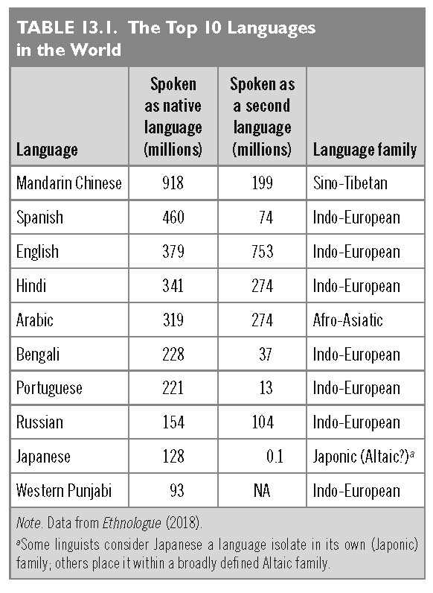
This slide is a supplement to A Geography of Russia and Its Neighbors, Second Edition by Mikhail S. Blinnikov. Copyright © 2021 The Guilford Press.

Slide 10
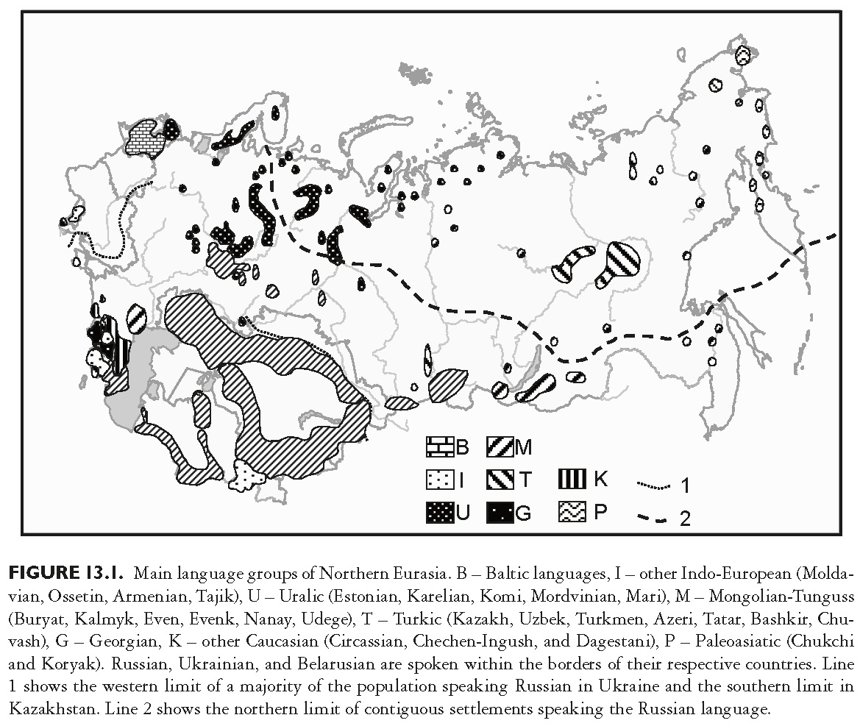
This slide is a supplement to A Geography of Russia and Its Neighbors, Second Edition by Mikhail S. Blinnikov. Copyright © 2021 The Guilford Press.

Slide 11
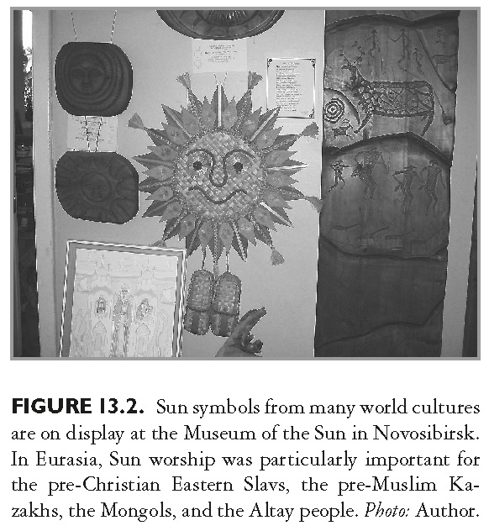
This slide is a supplement to A Geography of Russia and Its Neighbors, Second Edition by Mikhail S. Blinnikov. Copyright © 2021 The Guilford Press.

Slide 12
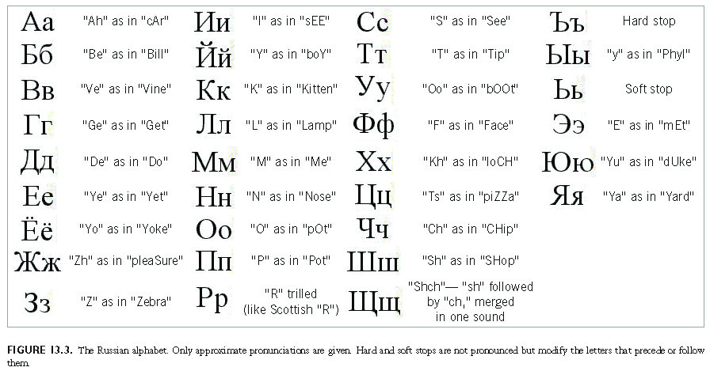
This slide is a supplement to A Geography of Russia and Its Neighbors, Second Edition by Mikhail S. Blinnikov. Copyright © 2021 The Guilford Press.

Slide 13
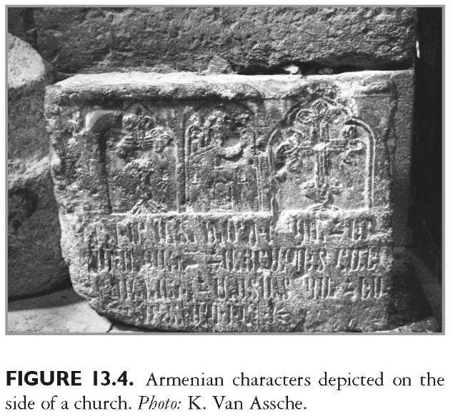
This slide is a supplement to A Geography of Russia and Its Neighbors, Second Edition by Mikhail S. Blinnikov. Copyright © 2021 The Guilford Press.

Slide 14
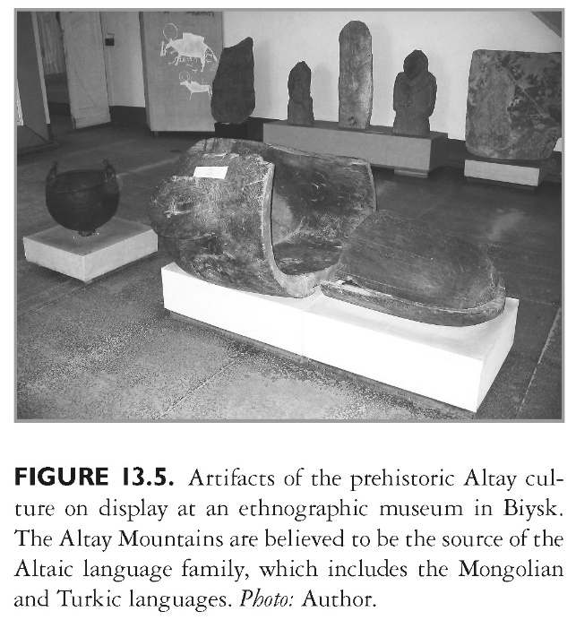
This slide is a supplement to A Geography of Russia and Its Neighbors, Second Edition by Mikhail S. Blinnikov. Copyright © 2021 The Guilford Press.

Slide 15
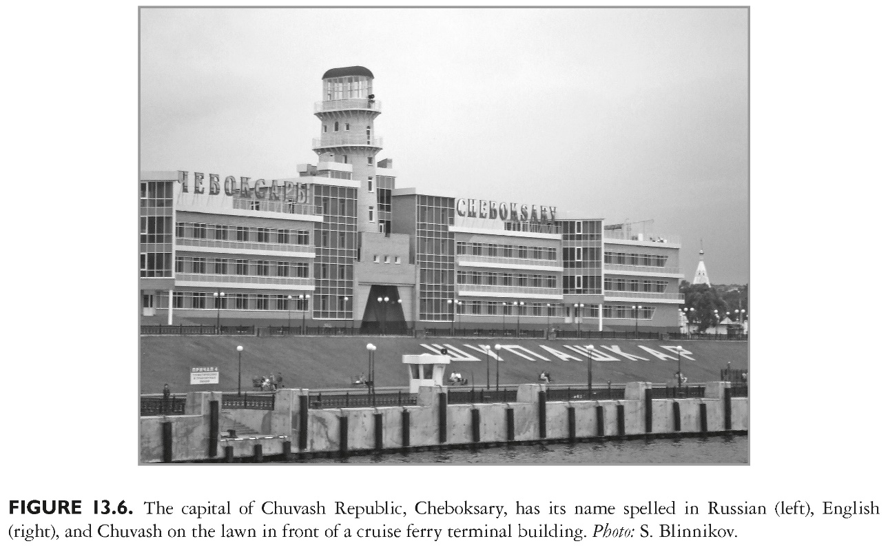
This slide is a supplement to A Geography of Russia and Its Neighbors, Second Edition by Mikhail S. Blinnikov. Copyright © 2021 The Guilford Press.

Slide 16
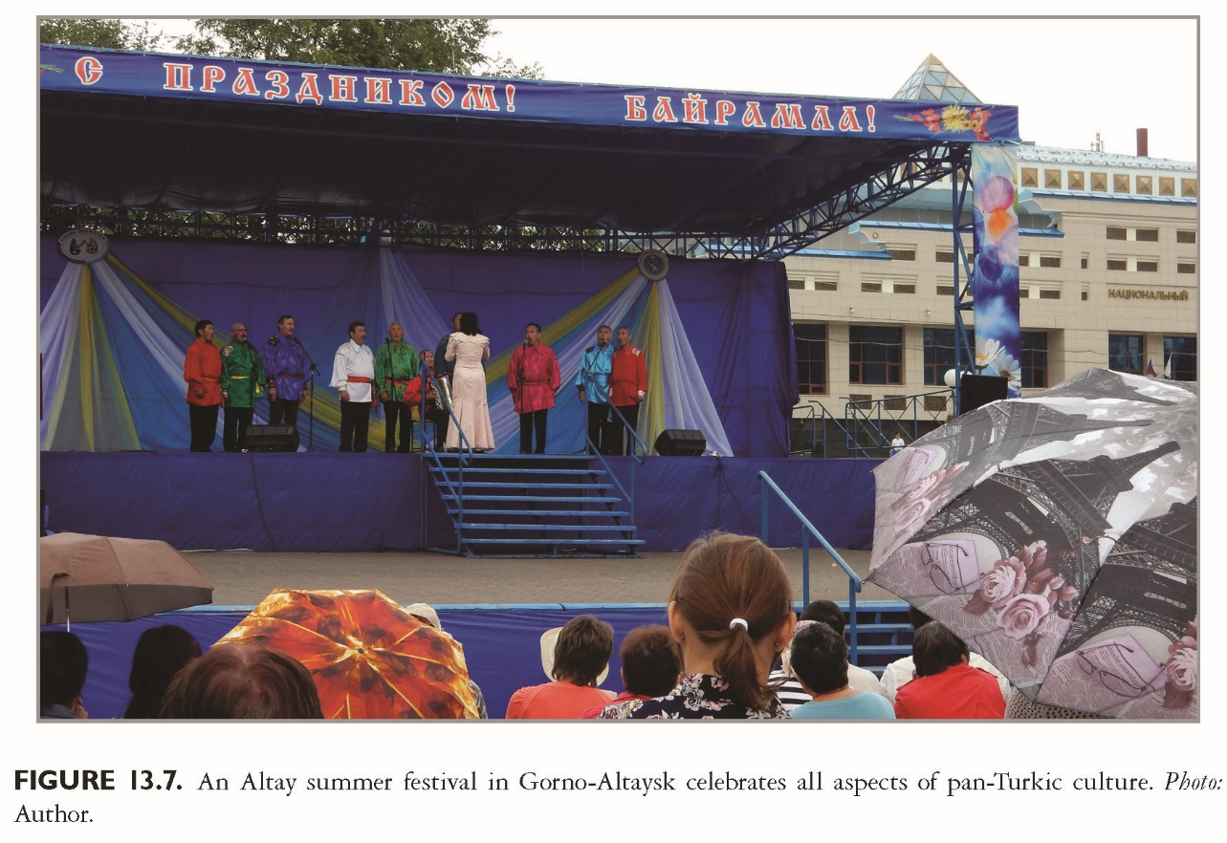
This slide is a supplement to A Geography of Russia and Its Neighbors, Second Edition by Mikhail S. Blinnikov. Copyright © 2021 The Guilford Press.

