Slide 1
This slide is a supplement to A Geography of Russia and Its Neighbors, Second Edition by Mikhail S. Blinnikov. Copyright © 2021 The Guilford Press.
Chapter 21. Infrastructure and Services
Transportation is developing
Railroads still carry the bulk of dry cargo and a big share of passengers
Aviation is developing, a few major airports upgraded, competition domestically among a few airlines is encouraged
Pipelines carry huge quantities of oil and gas domestically and internationally
Public transit is well developed in all cities and suburbs (bus, tram, train)
Cabs and especially riding sharing apps are ubiquitous
More and more families have at least one car
Retail sector is very diversified with lots of small companies and a handful of national or regional chains, some of which are Russian (X5 group, Lenta and Magnit), while others are foreign (Auchan is French and Metro is German)
Consumer goods are now widely available in Russia and other former Soviet republics
Photos of various regional malls with cheap and expensive shops
Some come from within the region trade, most come from China, Europe and a few countries in the Middle East (Turkey) or Asia (South Korea, Japan, Taiwan)
Consumer society is firmly entrenched in Russia
New stores from street to outdoor markets to supermarkets to megamalls

Slide 2
This slide is a supplement to A Geography of Russia and Its Neighbors, Second Edition by Mikhail S. Blinnikov. Copyright © 2021 The Guilford Press.
Russia is a very materialistic society
Brands matter a lot
Beer, vodka, coffee, soft drinks
Jeans, clothing in general
Cigarettes
Electronics
Cars
Shopping malls are everywhere, more than needed, half are somewhat empty of people, especially in the provincial cities with low wages
Online sales of just about everything, lots of companies depend on courier delivery (same day or overnight)
Massive logistic hubs built near every major city and airport
Tremendous variety of outdoor and indoor cafes and restaurants, all imaginable cuisines and some are very reasonably priced
Fast food is dominated by US-based and Russian chains
Book publishing –special case, because Russia remains a very literate society and people read a lot
Especially booming are contemporary fiction (all genres), clever non-fiction, textbook and specialized literature for professional, and books for children
Great bookstores and many online options

Slide 3
This slide is a supplement to A Geography of Russia and Its Neighbors, Second Edition by Mikhail S. Blinnikov. Copyright © 2021 The Guilford Press.
Another new sector that is booming is cell phone service/retail
Four companies dominate domestic market and have some presence in the near abroad
MTS, Beeline, Megafon and Tele2
the Internet (fixed and mobile) is thriving
Russia has some large and very innovative IT companies, e.g. Yandex and Mail.RU group, Kaspersky anti-virus company and many others
Russian language is #4 in the number of articles written on Wikipedia, ahead of Chinese, Spanish and Italian and behind only English, German and French in the fall of 2020

Slide 4
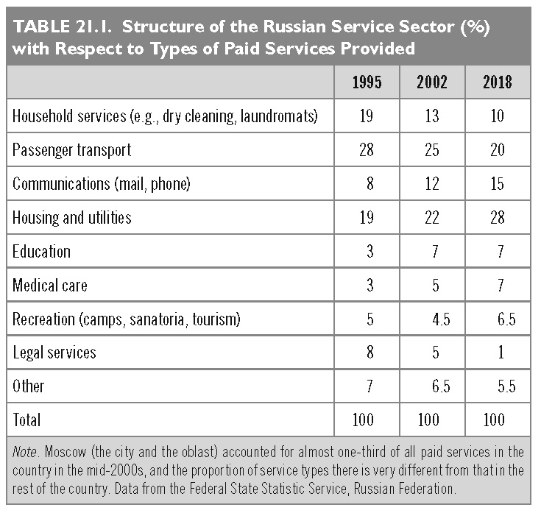
This slide is a supplement to A Geography of Russia and Its Neighbors, Second Edition by Mikhail S. Blinnikov. Copyright © 2021 The Guilford Press.

Slide 5
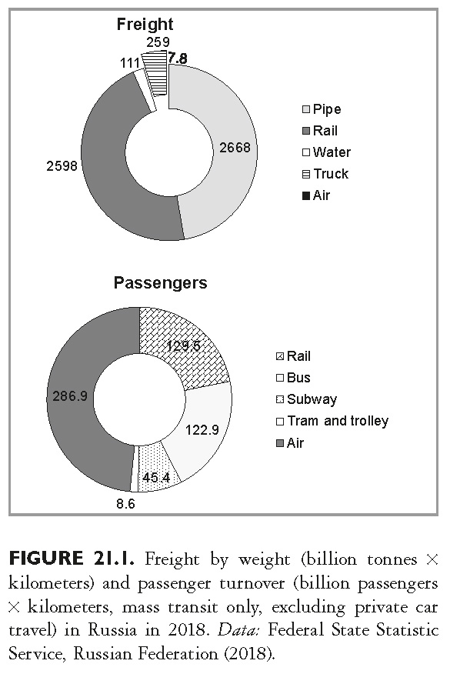
This slide is a supplement to A Geography of Russia and Its Neighbors, Second Edition by Mikhail S. Blinnikov. Copyright © 2021 The Guilford Press.

Slide 6
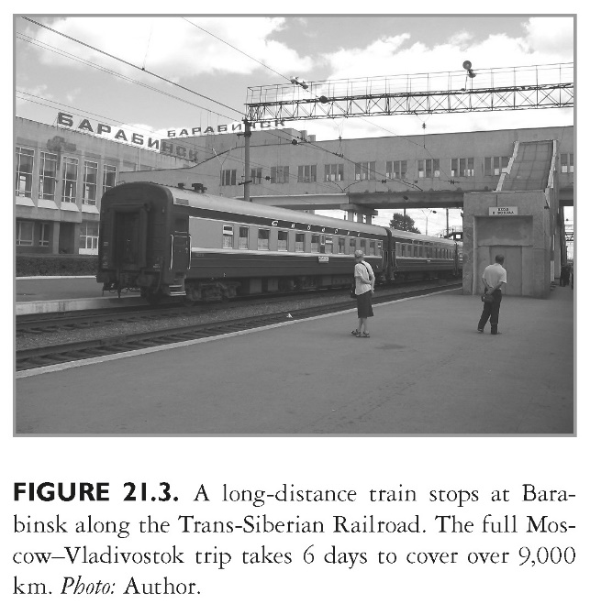
This slide is a supplement to A Geography of Russia and Its Neighbors, Second Edition by Mikhail S. Blinnikov. Copyright © 2021 The Guilford Press.

Slide 7
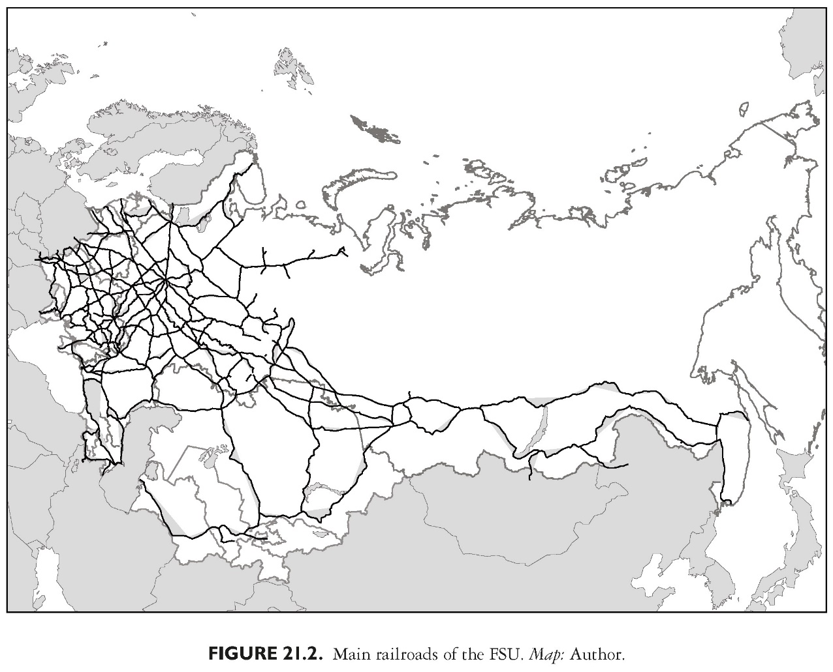
This slide is a supplement to A Geography of Russia and Its Neighbors, Second Edition by Mikhail S. Blinnikov. Copyright © 2021 The Guilford Press.

Slide 8
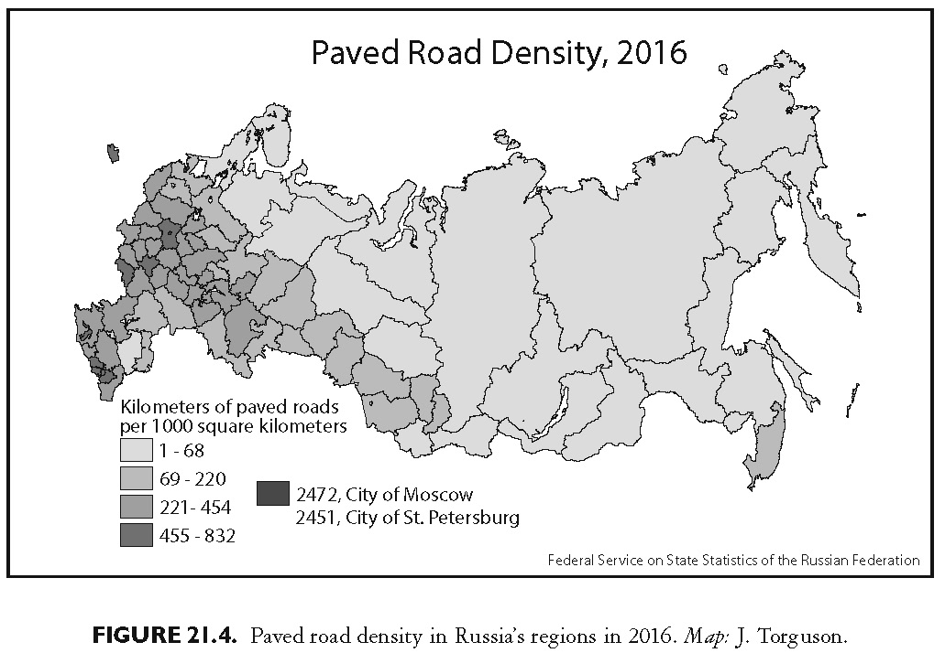
This slide is a supplement to A Geography of Russia and Its Neighbors, Second Edition by Mikhail S. Blinnikov. Copyright © 2021 The Guilford Press.

Slide 9
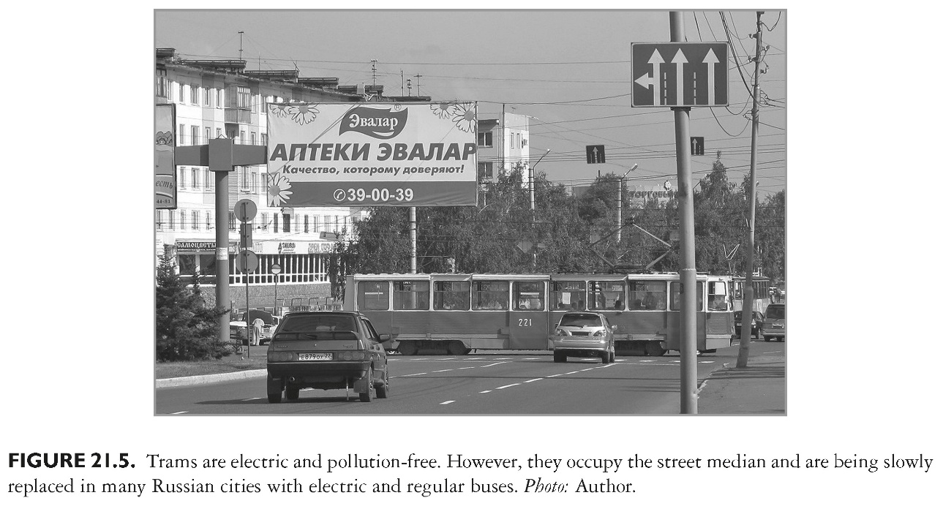
This slide is a supplement to A Geography of Russia and Its Neighbors, Second Edition by Mikhail S. Blinnikov. Copyright © 2021 The Guilford Press.

Slide 10
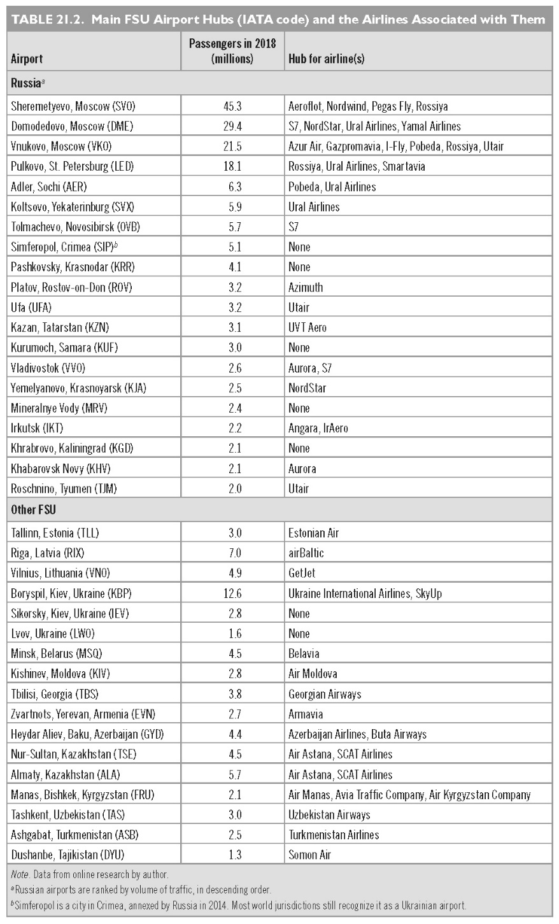
This slide is a supplement to A Geography of Russia and Its Neighbors, Second Edition by Mikhail S. Blinnikov. Copyright © 2021 The Guilford Press.

Slide 11
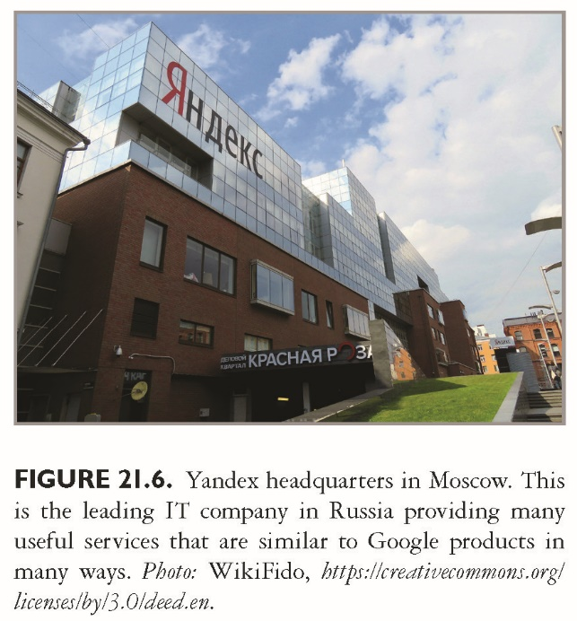
This slide is a supplement to A Geography of Russia and Its Neighbors, Second Edition by Mikhail S. Blinnikov. Copyright © 2021 The Guilford Press.

Slide 12
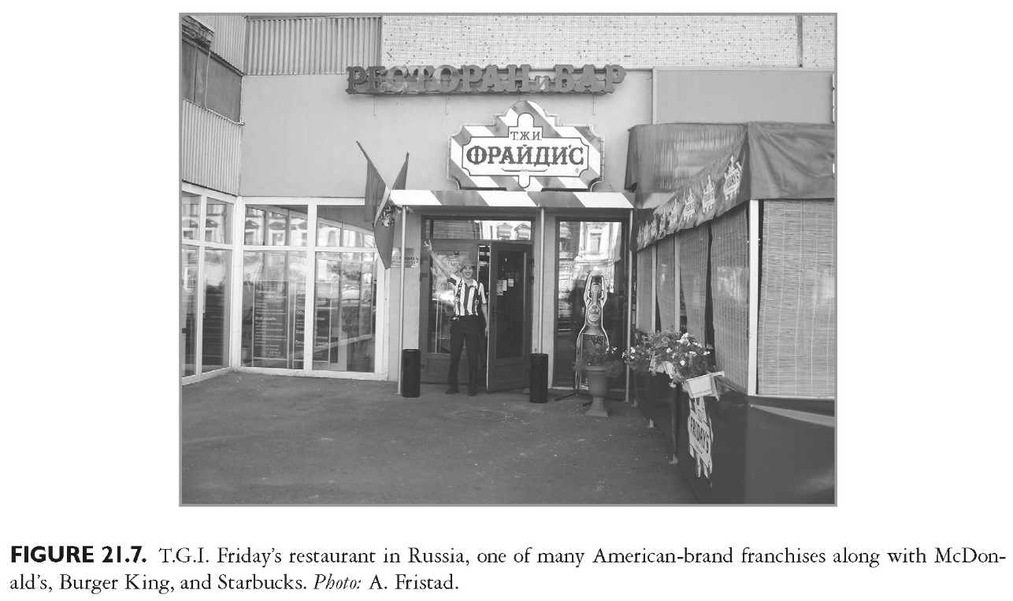
This slide is a supplement to A Geography of Russia and Its Neighbors, Second Edition by Mikhail S. Blinnikov. Copyright © 2021 The Guilford Press.

Slide 13
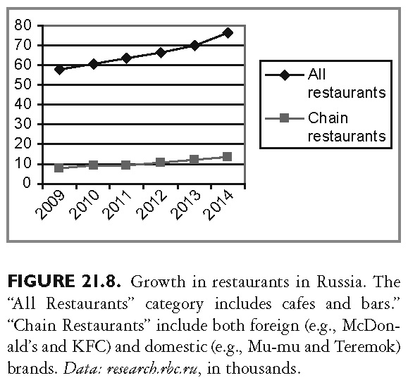
This slide is a supplement to A Geography of Russia and Its Neighbors, Second Edition by Mikhail S. Blinnikov. Copyright © 2021 The Guilford Press.

