Slide 1
This slide is a supplement to A Geography of Russia and Its Neighbors, Second Edition by Mikhail S. Blinnikov. Copyright © 2021 The Guilford Press.
Chapter 5. Environmental Degradation and Conservation
Is the region green paradise or hell?
Ecocide in USSR?
“When historians finally conduct an autopsy on the Soviet Union and Soviet Communism, they may reach the verdict of death by ecocide.” — a common western perspective
Not quite true, despite many environmental problems
Air pollution, especially from giant factories
Water pollution, dams
Radioactive fallout from nuclear testing in a few places (+Chernobyl and Kyshtym accidents)
Toxic waste from chemical factories
Overcut forests and overgrazed steppe
Too much hunting and poaching
Lack of environmental education/awareness
People struggle to survive and don’t care

Slide 2
This slide is a supplement to A Geography of Russia and Its Neighbors, Second Edition by Mikhail S. Blinnikov. Copyright © 2021 The Guilford Press.
Why environmental problems?
Something wrong with Communism?
We cannot beg nature for mercy, take what we need from it is our task. —Ivan Michurin
Capital is derived by capitalists primarily from human exploitation of labor. —Karl Marx
Centralized economy could foresee problems, no? (Not really, no incentive to do so)
Rapid and wasteful industrialization (as elsewhere – witness China now or USA 100 years ago)
Nuclear “superpower” and arms race with the US
Closed society, so few whistleblowers
Large and cold territory
Abundant resources encourage waste
Need a lot of infrastructure built
Need a lot of energy
Map of key problem areas in 1990s (public domain):
https://legacy.lib.utexas.edu/maps/commonwealth/russian_env96.jpg

Slide 3
This slide is a supplement to A Geography of Russia and Its Neighbors, Second Edition by Mikhail S. Blinnikov. Copyright © 2021 The Guilford Press.
Chernobyl nuclear accident
Happened in Pripyat, Ukraine near the city of Chernobyl north of Kiev
April 26, 1986
One of 4 reactors blew up – why? (Planned experiment that went wrong.)
28 deaths soon, Thousands?? later
200,000 people displaced
600,000 workers in 1985–1990 to clean up
180 t of UO₆ in the core – about 25% escaped (x400 Hiroshima bombs)
Bad reactor design – graphite control rods, not pressurized water as is more common in the West and in modern Russian reactors
Core melted, rods could not go back in, hydrogen gas exploded
60% of fallout in Belarus
Shut down all work in 2000
Old containment hangar leaking – replaced in 2019
Chernobyl surprisingly patchy contamination map – not everywhere got hit
https://en.wikipedia.org/wiki/Chernobyl_Exclusion_Zone

Slide 4
This slide is a supplement to A Geography of Russia and Its Neighbors, Second Edition by Mikhail S. Blinnikov. Copyright © 2021 The Guilford Press.
Life after Chernobyl
Station closed in 2000
Containment building erected, but lots of leaks (recently replaced with a new one)
Radiation “park” at Pripyat town with tours
Relatively little health impact beyond the immediate vicinity
http://pripyat.com/ – lots of visitors’ impressions
Current nuclear issues in the region
Ukraine and Kazakhstan gave up their nuclear warheads to Russia after 1991
Existing nuclear plants are numerous and Russia is building more (Belarus in 2020)
Former testing sites are very contaminated (Semey, Kazakhstan and Novaya Zemlya)
Export of Russia-made plutonium to USA
Import of nuclear waste from France and Germany
Can terrorists get the stuff to make a dirty bomb?
Is nuclear war between Russia and USA possible?

Slide 5
This slide is a supplement to A Geography of Russia and Its Neighbors, Second Edition by Mikhail S. Blinnikov. Copyright © 2021 The Guilford Press.
Air pollution is generally down from fixed sources, way up from cars and trucks since 1990 (changing economy)
Tomsk conventional power station (coal/gas)
Novosibirsk power station (heating oil known as mazut)
Norilsk nickel smelter (1935)
Norilsk and environs map
Oskemen, KZ
Air pollution from traffic in Moscow is visible from space (and also on the ground)
Cutting trees all around to build more housing and roads makes things worse
Water issues
Aral Sea goes dry!
Dams on largest rivers, including 11 on the Volga and a few on the Yenisei and Ob and their tributaries
Lena and Amur remain dam-free, for now
A lot of water pollution in the most industrialized parts (the Volga, the Dnieper, rivers in the Urals)

Slide 6
This slide is a supplement to A Geography of Russia and Its Neighbors, Second Edition by Mikhail S. Blinnikov. Copyright © 2021 The Guilford Press.
Soviet “Greens”
After school naturalist programs
“Druzhina” student conservation corps movement started in 1960 (all major universities had one)
Late 1960s – Lake Baikal initiative to save the lake, promoted by celebrities
1986 – anti-nuclear movement, including first radical action groups (“Rainbow keepers”, for example)
1990s – neighborhood env-tal groups emerge, successful fight against building Katun Hydropower station on the source of the Ob river in the Altay mountains
1990 – Socio-Ecological Union founded as an umbrella
1990s – professionalization of the movement, western grants and new NGOs
After 2000 – big professionals (Greenpeace and WWF-Russia) – but very uncertain future now with Russia being very isolationist
Recent example: Khimki forest battle near Moscow (2011) to save it from being cut in two by a high-speed toll road (delayed by 1.5 years, but the road was still built)
Severe forest impact: two fragments <300 ha, many tiny ones, severe edge effects
Partially destroys planned zakaznik in a bog
Impacts Klyazma floodplain
Other alternatives exist, but the project enjoys support of PM V. Putin and Minister of Transportation Levitin

Slide 7
This slide is a supplement to A Geography of Russia and Its Neighbors, Second Edition by Mikhail S. Blinnikov. Copyright © 2021 The Guilford Press.
Current status
Russian federal government is fairly pro-big business and so anti-environmental
It is very pro-oil and gas – large interests in extractive industry
Regional governments can be more pro-nature, but are usually underfunded and corrupt
High-level poaching among government elite, even game wardens themselves
Some good laws (e.g., Law on Environment Protection) exist, but with poor enforcement
NGOs are numerous, but not very powerful – narrow supporter base and is sometimes perceived as a threat to national interests by the local law enforcement and public at large
Some good nature education available, but lack of common awareness (environment concerns are not even in the top 10)
Rise of local protest movements, like Khimki forest group and many neighborhood associations to save local parks from being paved and built over
Protected Areas of Russia
Zapovedniks (IUCN category Ia)
Began in 1916 and are based on the idea of ecological representation of all major natural zones
100 (about 1% of territory)
Strict scientific nature reserves and wildernesses – and almost no tourism allowed

Slide 8
This slide is a supplement to A Geography of Russia and Its Neighbors, Second Edition by Mikhail S. Blinnikov. Copyright © 2021 The Guilford Press.
3 main functions of zapovedniks
Wilderness Preservation
Environmental Baseline Monitoring
Environmental Education
Discussion: How Russian zapovedniks differ from US national parks?
National Parks (IUCN category II)
30 created since 1980s
Mainly tourism-oriented, much more than zapovedniks
Zakazniks (game, botanical and other types of sanctuaries) (IUCN category IV) 1500 are at the regional level
Nature Monuments – small and unique places
Regional Nature Parks, parks-museums

Slide 9
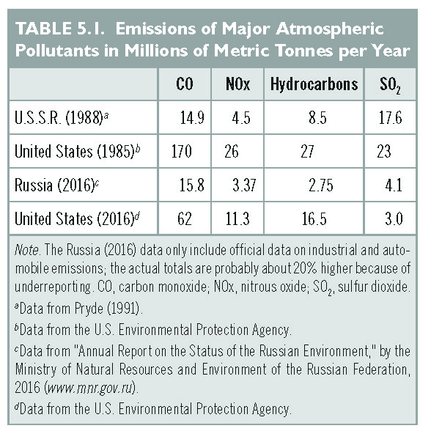
This slide is a supplement to A Geography of Russia and Its Neighbors, Second Edition by Mikhail S. Blinnikov. Copyright © 2021 The Guilford Press.

Slide 10
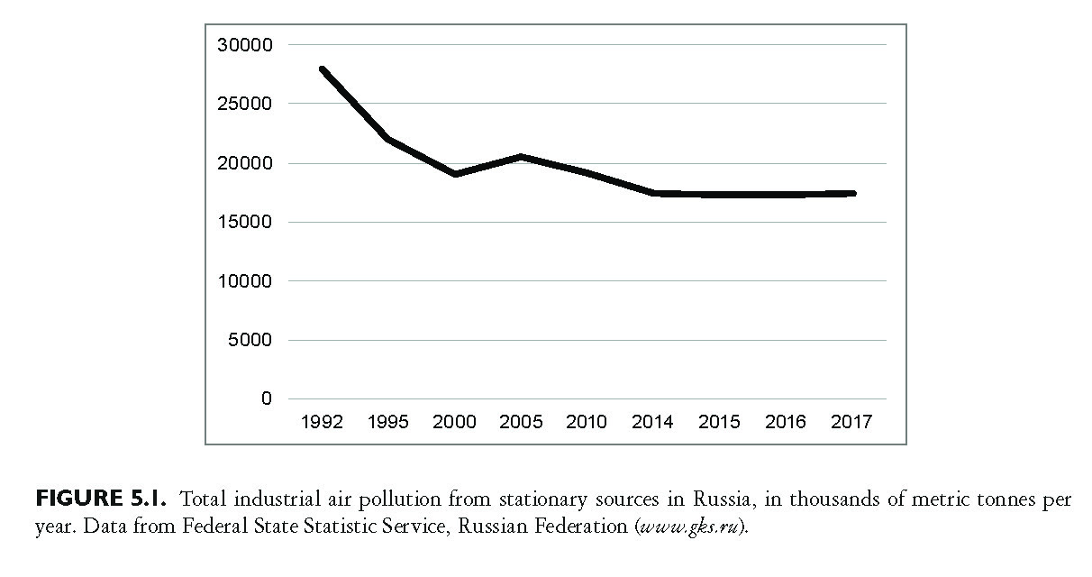
This slide is a supplement to A Geography of Russia and Its Neighbors, Second Edition by Mikhail S. Blinnikov. Copyright © 2021 The Guilford Press.

Slide 11
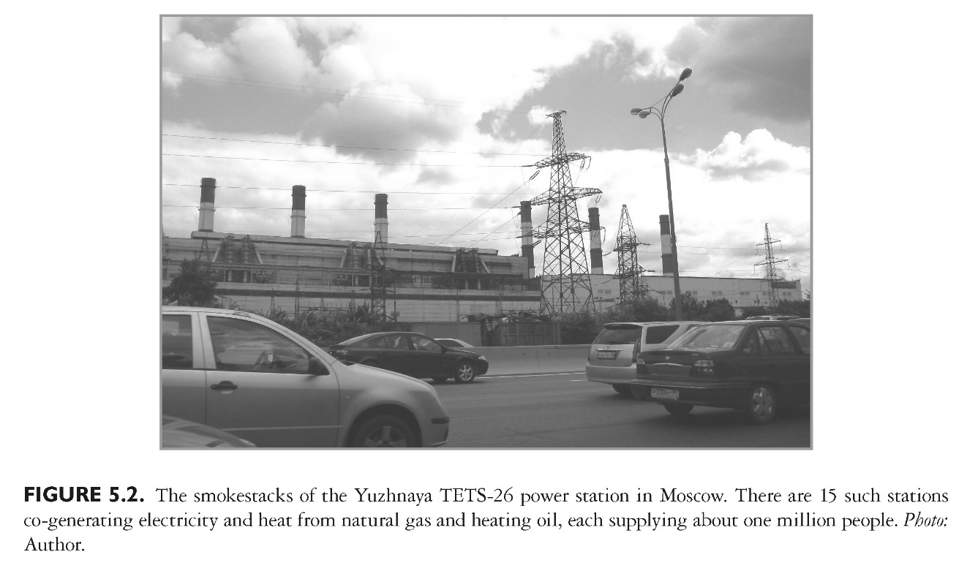
This slide is a supplement to A Geography of Russia and Its Neighbors, Second Edition by Mikhail S. Blinnikov. Copyright © 2021 The Guilford Press.

Slide 12
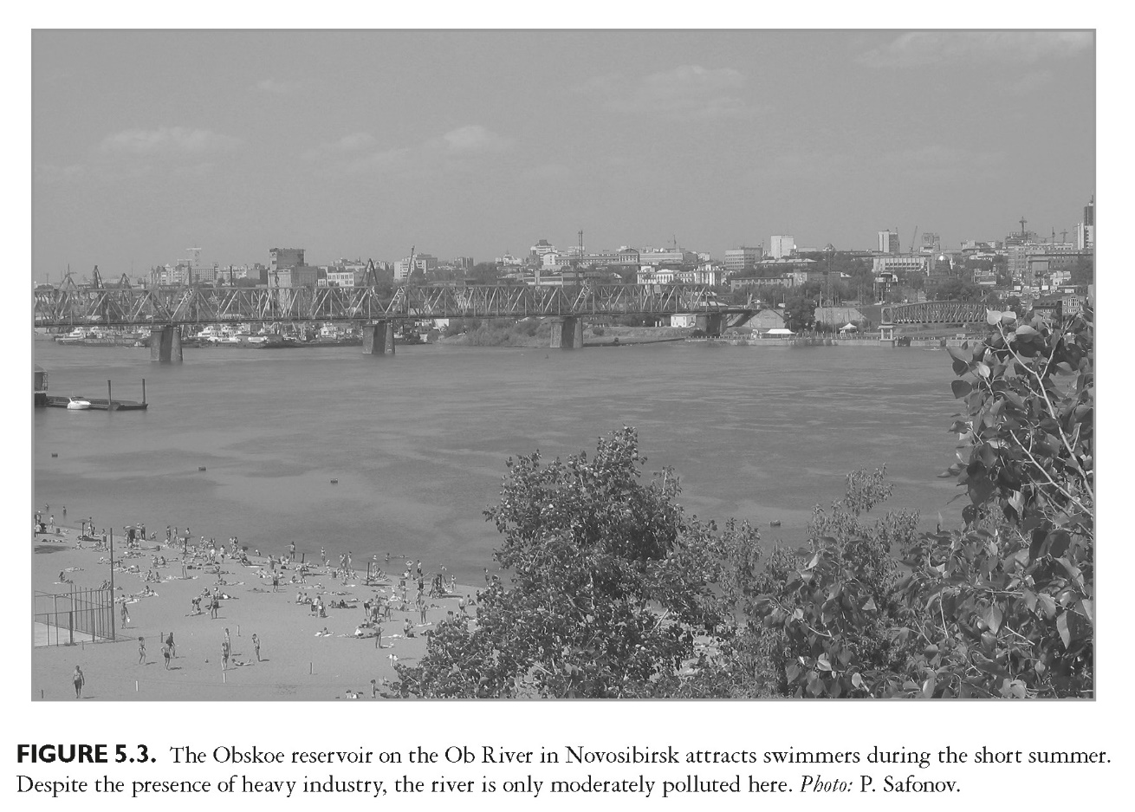
This slide is a supplement to A Geography of Russia and Its Neighbors, Second Edition by Mikhail S. Blinnikov. Copyright © 2021 The Guilford Press.

Slide 13
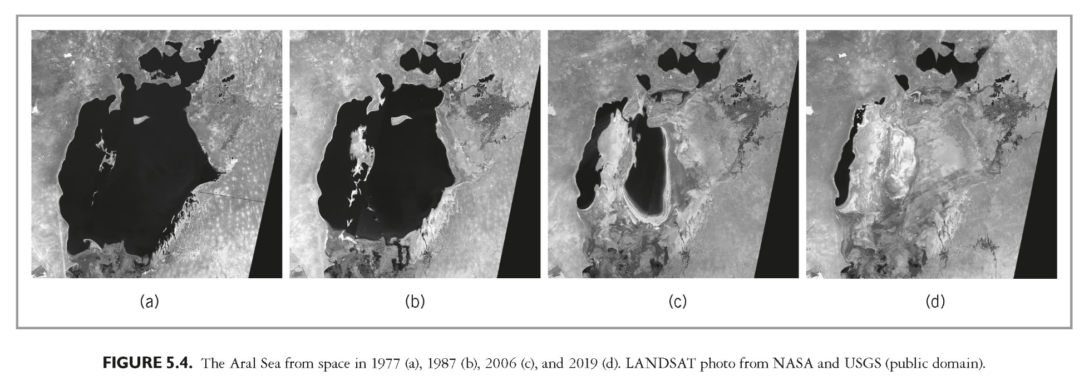
This slide is a supplement to A Geography of Russia and Its Neighbors, Second Edition by Mikhail S. Blinnikov. Copyright © 2021 The Guilford Press.

Slide 14
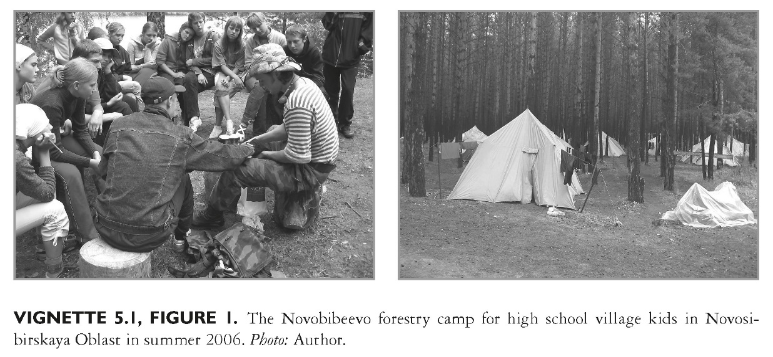
This slide is a supplement to A Geography of Russia and Its Neighbors, Second Edition by Mikhail S. Blinnikov. Copyright © 2021 The Guilford Press.

Slide 15
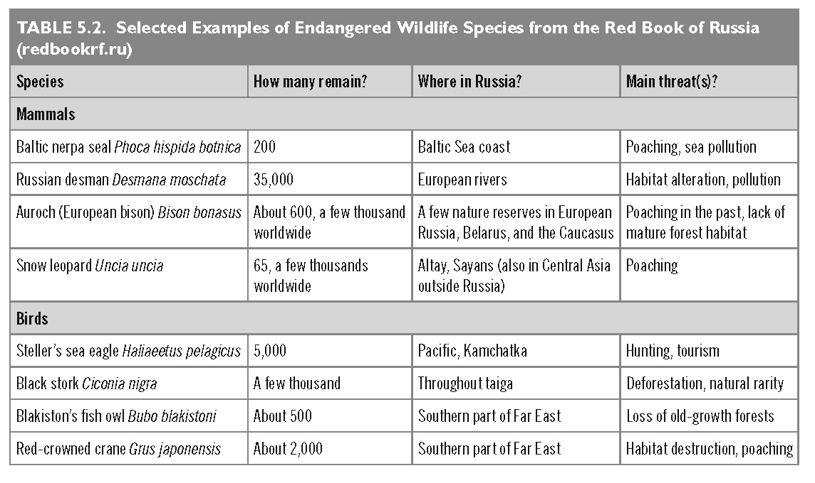
This slide is a supplement to A Geography of Russia and Its Neighbors, Second Edition by Mikhail S. Blinnikov. Copyright © 2021 The Guilford Press.

