Slide 1
This slide is a supplement to A Geography of Russia and Its Neighbors, Second Edition by Mikhail S. Blinnikov. Copyright © 2021 The Guilford Press.
Chapter 12. Social Issues: Health, Wealth, Poverty, and Crime
The Soviet Union was a socialist welfare state
State owned everything – all means of production, specifically
Socialist ideal: from each according to abilities, to each according to one’s labor
100% employment and no official homeless people or “bums”
Free child care, school, college (~20% finished university)
Free universal health care (really!)
Mass transit was well developed and expected
Private property existed only for personal belongings
Egalitarian payscale – Gini index <0.3 (today 0.45)
A low category worker made Rub 80–100/month
Teacher made Rub 120
Scientist or engineer made Rub 180–250
Director of a factory or Army general made Rub 800
Questions for in-class discussion
What is the common pay scale difference for US or UK workers?
Where can you find socialist welfare system in the world today?
Is Bernie Sanders a Soviet-style socialist?

Slide 2
This slide is a supplement to A Geography of Russia and Its Neighbors, Second Edition by Mikhail S. Blinnikov. Copyright © 2021 The Guilford Press.
Some health trends since 1990 (Figure 12.1)
Health care in Russia today
Hybrid system: state clinics and private clinics
State system is underfunded (“optimized” under V. Putin), but is still available and easy to use, doctors and nurses come to your home if you are sick
Private system is unaffordable to many, but is extremely convenient, for example many clinics are open 9 am to 9 pm 7 days a week with minimal wait time
Major differences with US system:
More holistic
More preventative
Less regulated drug market (imports of just about anything from every country in the world that makes drugs, so there is a tremendous selection)
Big geographical gaps
Imported equipment is typical, some is domestic
Post-operative care poor
Doctors make only x2 average salary, not x5–10

Slide 3
This slide is a supplement to A Geography of Russia and Its Neighbors, Second Edition by Mikhail S. Blinnikov. Copyright © 2021 The Guilford Press.
Photos
Typical city clinic (public)
Typical large hospital
Typical private pharmacy
Typical private clinic in a major city
Mortality factors in 2011 per 100,000
Russia USA
Cardiovascular 753 212
Cancer 205 169
External 139 39
Suicides 22 12
Traffic accidents 21 11
Murders 12 5
Alcohol poisonings 11 12 (with drug overdoses added)
Digestive and kidney 62 35
Pulmonary 52 43
Infections 24 16

Slide 4
This slide is a supplement to A Geography of Russia and Its Neighbors, Second Edition by Mikhail S. Blinnikov. Copyright © 2021 The Guilford Press.
Income distribution
Soviet Union was very egalitarian
However, statistics are poorly comparable to the West, because the economy was very different (e.g., lots of things were free, while some were not available at all)
Russia went through an unprecedented drop in GDP and living standards, especially between 1992 and 1998: $5,000/capita PPP was average
Today life is much better, GDP $27,000/capita PPP
Income distribution, however, is fairly uneven:
Top 10% Bottom 10% Gini
USA 30% 2% 45
Russia 30.4% 1.9% 42
Sweden 22.2% 3.6% 23
Brazil 43% 1.1% 51.9
Figure 12.3. Monthly income distribution in rubles in Russia’s households (2018)

Slide 5
This slide is a supplement to A Geography of Russia and Its Neighbors, Second Edition by Mikhail S. Blinnikov. Copyright © 2021 The Guilford Press.
See Gapminder project’s Dollar Street to visualize “average household” in Russia or Ukraine
https://www.gapminder.org/dollar-street
Polarized society: Billionaires vs. Bums
Too many billionaires in Russia relative to the size of its economy
There were 2,043 dollar billionaires worldwide in 2017, of which
96 were in Russia (USA had about 550 and China had 350)
Ukraine had 6
Kazakhstan had 5
Georgia had 1 (and that person made all of his money in Russia)
While Russia’s economy was only 6th largest in the world by PPP and only 75th per capita
Look up Forbes Russia top 100 list www.forbes.com/billionaires
Read about ONE person on the list from the top 30
What is the source of his (her, there were 2 women) fortune?
Which industri(es) does s/he represent?
How is this different from the top of the USA list?

Slide 6
This slide is a supplement to A Geography of Russia and Its Neighbors, Second Edition by Mikhail S. Blinnikov. Copyright © 2021 The Guilford Press.
Most “state budget” workers, pensioners, single moms are struggling
Russia has officially 13% below the very low poverty threshold, or about 20 million people barely able to afford even food
Crime and other statistics
UN Survey of Crime Trends (late 1990s)
Russia was 5th worst out of 62 countries in murders per capita (about 5x the US rate); somewhat better now
Robberies were only 2/3 of US level
Most violent crime is between family members
Journalists, businessmen, ethnic minorities are the likeliest targets
Prisoners ~800,000
Subjective assessment of danger
Corruption Perception Index
Russia in 133rd place/174 in 2013
Ukraine 144, Uzbekistan 170!!!
Estonia 32
Georgia 51
USA 19
Denmark 1
Somewhat biased by the choice of experts

Slide 7
This slide is a supplement to A Geography of Russia and Its Neighbors, Second Edition by Mikhail S. Blinnikov. Copyright © 2021 The Guilford Press.
Corruption
Corruption in Russia is very high
Exposed regularly by various online media and especially by Alexey Navalny of the Fond for Corruption Prevention (or FBK). He is one of the most popular video bloggers in Russia and survived a poisoning attempt in the summer of 2020
More importantly, corruption is embedded in the system of V. Putin’s government
Corruption Perception Index (176 in 2016)
Uzbekistan 156th
Russia, Ukraine, Kazakhstan 131th
Moldova 123rd
Georgia 44th
Bulgaria 75th
USA 18th
Sweden 4th

Slide 8
This slide is a supplement to A Geography of Russia and Its Neighbors, Second Edition by Mikhail S. Blinnikov. Copyright © 2021 The Guilford Press.
Brainstorm how to fight corruption in Russia
How can Russia win in the battle against corruption?
Forms of corruption
Bribes – money and favors to do something
Embezzlement – stealing funds from the state or commercial firms
Kick-backs – paying officials for the state contracts that they distribute to private firms
Extortion – forcing a payment under threat
Abuse of discretion – keeping eyes closed and not listening to whistleblowers
Nepotism – enriching friends and family – extremely common
Corruption gain = Penalty × Likelihood of being caught and prosecuted (Klitgaard, 1998)
Degree of corruption = Monopoly + Discretion – Transparency – Morality (Stephan, 2012)

Slide 9
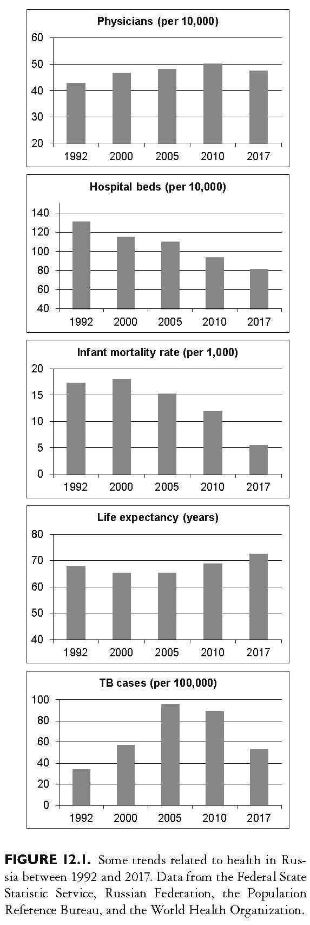
This slide is a supplement to A Geography of Russia and Its Neighbors, Second Edition by Mikhail S. Blinnikov. Copyright © 2021 The Guilford Press.

Slide 10
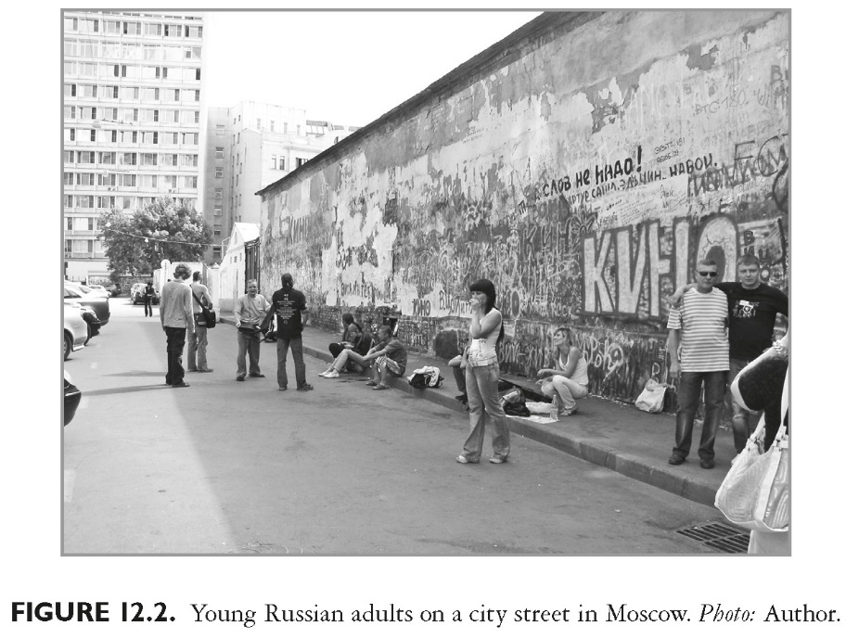
This slide is a supplement to A Geography of Russia and Its Neighbors, Second Edition by Mikhail S. Blinnikov. Copyright © 2021 The Guilford Press.

Slide 11
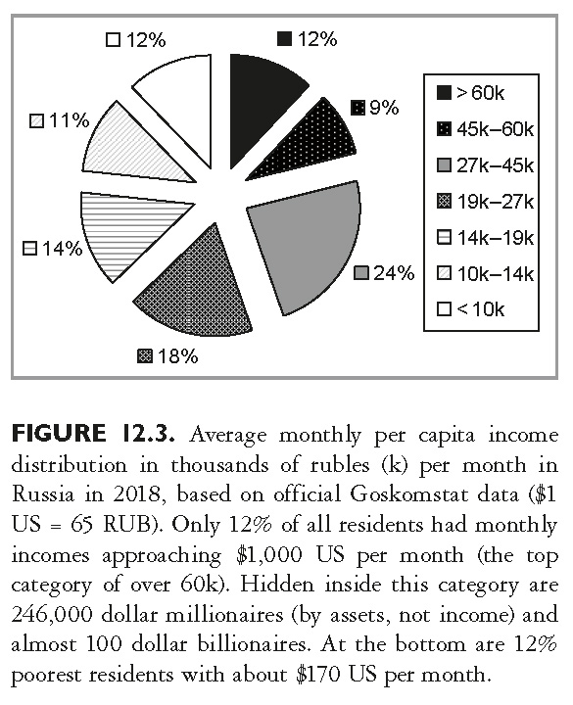
This slide is a supplement to A Geography of Russia and Its Neighbors, Second Edition by Mikhail S. Blinnikov. Copyright © 2021 The Guilford Press.

Slide 12
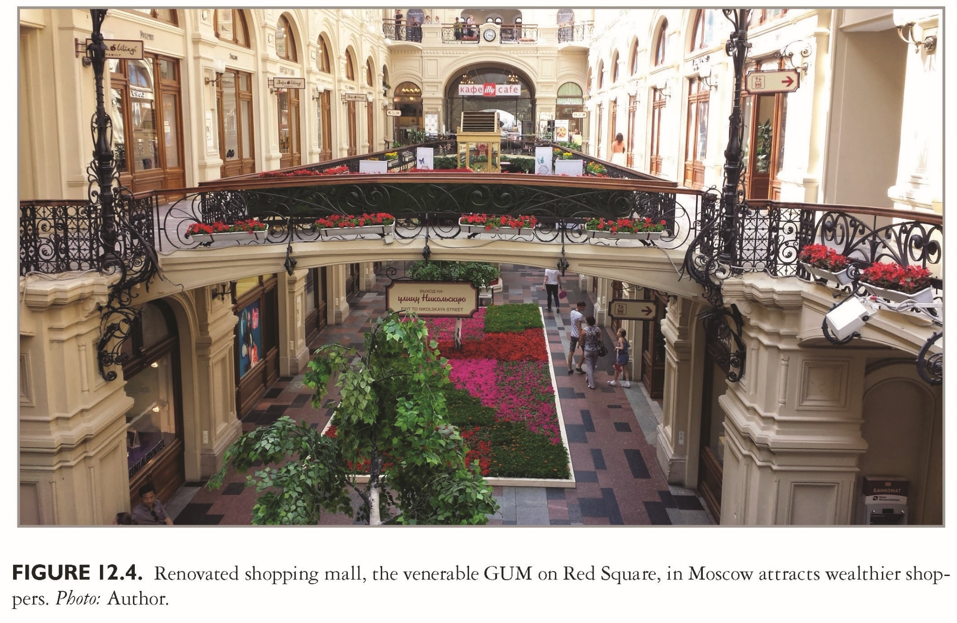
This slide is a supplement to A Geography of Russia and Its Neighbors, Second Edition by Mikhail S. Blinnikov. Copyright © 2021 The Guilford Press.

Slide 13
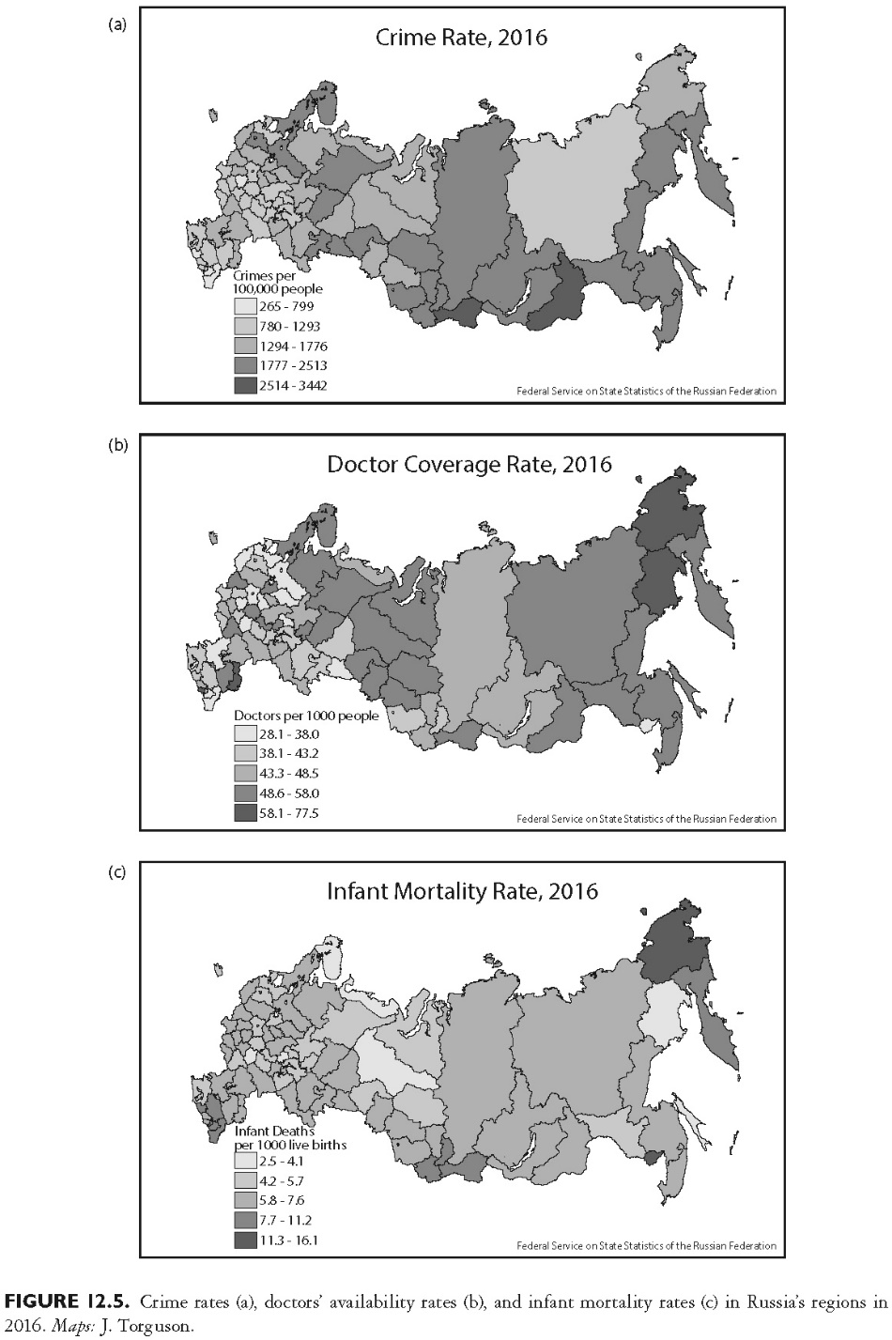
This slide is a supplement to A Geography of Russia and Its Neighbors, Second Edition by Mikhail S. Blinnikov. Copyright © 2021 The Guilford Press.

Slide 14
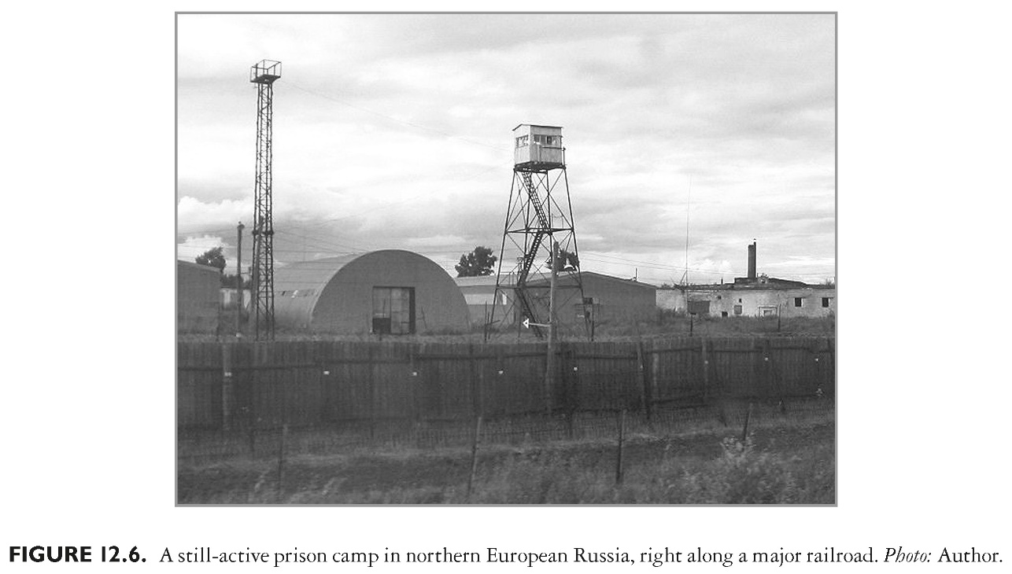
This slide is a supplement to A Geography of Russia and Its Neighbors, Second Edition by Mikhail S. Blinnikov. Copyright © 2021 The Guilford Press.

Slide 15
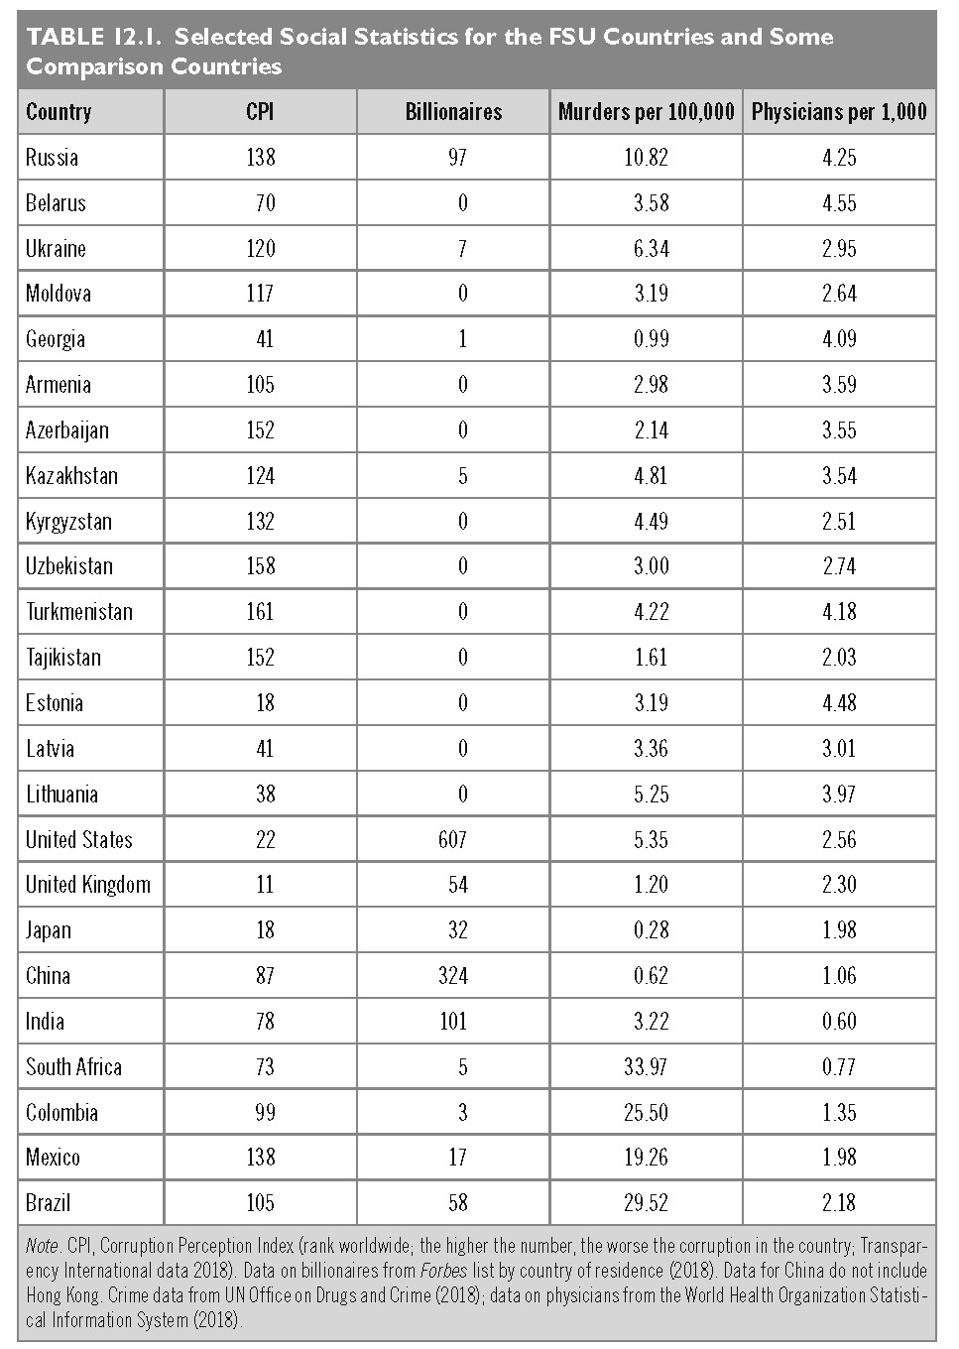
This slide is a supplement to A Geography of Russia and Its Neighbors, Second Edition by Mikhail S. Blinnikov. Copyright © 2021 The Guilford Press.

