Slide 1
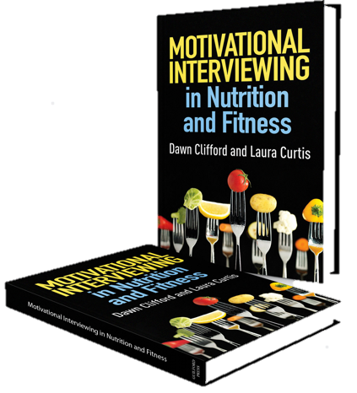
Nutrition & Fitness Industries: MI in Nutrition Counseling
Chapter 13
Companion slides to Motivational Interviewing in Nutrition and Fitness
ISBN: 9781462524181 © 2016 Dawn Clifford and Laura Curtis
Guilford Press • 370 Seventh Ave Suite 1200 • New York, NY, 10001-1020 • guilford.com

Slide 2
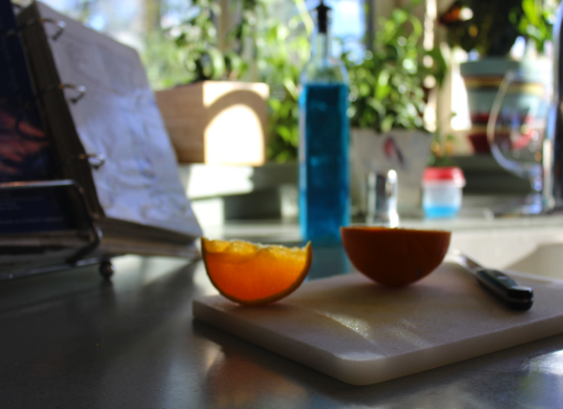
Learning Objectives
By the end of this presentation, participants will be able to:
Present dietary information for disease management in an MI-adherent way
List open-ended questions that invite clients to share meal planning preferences
Describe strategies that can be used
to support clients in expanding
food variety
Define habituation
Describe mindful eating

Slide 3
Outline
Managing disease
Meal planning
Expanding food variety
Navigating food cravings
“Dietary changes can be challenging, as clients often have emotional and cultural ties to food.”
Clifford & Curtis
motivatechange.net

Slide 4
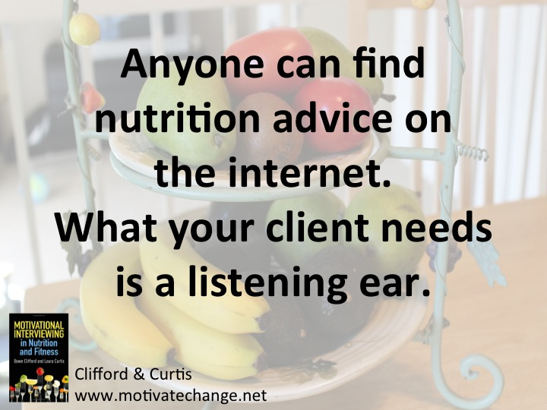

Slide 5
Dietary Changes to Manage Disease
A new diagnosis can feel overwhelming.
Provide a space for clients to process their new diagnosis.
Ask open-ended questions:
What was it like to receive that diagnosis?
What concerns you most about the diagnosis?
How might this diagnosis change the way you do things?
Reflect any change talk that surfaces.

Slide 6
Dietary Changes to Manage Disease
Be careful not to overwhelm your client with facts, figures, and food rules.
Use a guiding style to collaborate with your client on the focus of the session.
“Here is a list of changes that clients with this condition often make. Do any of these jump out at you as a good place to start exploring?”

Slide 7
Dietary Changes to Manage Disease
Guide your client towards changes that…
are small
are manageable
maximize taste
minimize preparation time
the client will likely stick with
occur gradually over time (if possible)

Slide 8
Meal Preparation and Planning
Most dietary changes require a tweak in meal preparation, planning, or both.
Where is your client getting stuck when it comes to planning for eating?
Shopping
Planning
Cooking

Slide 9
Meal Preparation and Planning
Clients often need help with contextual skills:
Skills to prepare and plan for regular, reliable meals and snacks
When should I shop?
What foods should I buy?
What do I cook? How do I cook?
How do I bring food with me?
Satter, 2008

Slide 10
Meal Preparation and Planning
Planning for Eating
Questions for your client:
Describe your current grocery shopping habits. How do you determine what you will eat each week?
What’s working well for you in how you plan your meals? Not working?
What would need to change, with regards to meal planning, to support this change you’re interested in making?

Slide 11
Meal Preparation and Planning
Preparing Meals
Questions for your client:
What are your go-to meals?
Tell me about the foods you prepare on a regular basis.
How comfortable are you in the kitchen?
How long do you prefer to spend preparing a (breakfast, lunch, dinner) meal?

Slide 12
Meal Preparation and Planning
Preparing Meals
Clients typically want their meals to be:
quick
easy
inexpensive
tasty

Slide 13
Meal Preparation and Planning
Preparing Meals
What do your clients need?
Recipe ideas?
Cooking knowledge and skills?
Cost-savings techniques?
Time-saving tips?
Assistance creating a meal list for the week?
Assistance creating a shopping list?

Slide 14
In Class Activity
Pair up with a classmate.
Take turns interviewing one another about your current meal planning strategies.
Questions you might ask your partner include:
Where do you usually eat? Where do you usually get your food?
How do you figure out what you’re going to eat/cook?
Describe your grocery shopping pattern. How do you determine what you will buy at the grocery store?
What information might make your own food planning and preparing easier in the future?
Reflect and summarize your partner’s responses throughout the conversation
Don’t try to change behavior. Just explore and inquire with curiosity and non-judgment.

Slide 15
Expanding Food Variety
Clients sometimes have a narrow selection of food.
Being a “picky eater” is often a result of parent feeding techniques used growing up.
Might be worth exploring past food struggles.
Repeated exposure to a disliked food can lead to food acceptance.
Invite your client to consider how he or she might re-try and experiment with new foods.

Slide 16
Expanding Food Variety
Brainstorm new sauces and seasonings to enhance palatability.
Discuss new cooking strategies that can enhance flavors.
Invite your client to consider a food that he or she previously disliked and now enjoys.
How did this happen? What led to that shift?

Slide 17
Expanding Food Variety
For clients with limited food selection, explore food likes and dislikes by brainstorming lists.
Likes | Foods in Between | Dislikes
Apples Carrots Corn Potatoes Bread Pasta Chicken breasts Cheese Red meat Ranch dressing Peanut butter | Turkey Broccoli Tomatoes (salsa and tomato sauce are ok) Beans | Celery Onions Bell peppers Chicken thighs Fish Bananas Melon Cauliflower

Slide 18
Expanding Food Variety
Invite client to mix and match liked and disliked foods, or try different versions or cooking styles.
Likes | Foods in Between | Dislikes
Apples Carrots Corn Potatoes Bread Pasta Chicken breasts Cheese Red meat Ranch dressing Peanut butter | Turkey Broccoli Tomatoes (salsa and tomato sauce are ok) Beans | Celery Onions Bell peppers Chicken thighs Fish Bananas Melon Cauliflower

Slide 19
Navigating Food Cravings
How do you respond to a client who says,
“I crave chocolate all the time! I can’t even keep it in the house. I’ll eat the whole box.”
Cravings, and the urge to eat in absence of hunger, are complex.
Emotions are often at play and worth exploring.
The driving force is the belief that the craved food is “bad” and therefore, should be avoided.

Slide 20
Navigating Food Cravings
Labeling food as “good” or “bad” keeps clients stuck.
Cravings are exacerbated by feelings of guilt.
Worry over calories (or fat, carbs, etc.) and body weight can make it hard to listen to what the body truly wants.
Keeping commonly craved foods out of the house often results in binging…
on other foods in the house that don’t adequately satisfy the craving.
when craved foods are later made available (like at a party).

Slide 21
Navigating Food Cravings
The answer?
HABITUATION
Repeated exposure to a stimulus that leads to a decreased response.

Slide 22
Navigating Food Cravings
Habituation
Invite your clients to stock their cupboards with the feared food.
The client will likely overeat at first, but then realize the food will always be there.
A fully stocked cupboard means your client can start tuning into cravings and responding to them as they arise.

Slide 23
Navigating Food Cravings
Habituation
Habituation alleviates the anxiety for that particular food, building a healthier relationship with the food.
Full permission to enjoy preferred foods reduces guilt and shame, helping clients break free from the dieting mindset.
Body image counseling and therapy for binge eating disorder may be needed prior to habituation experiments.

Slide 24
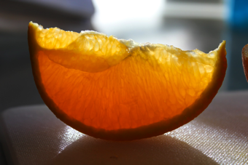
Navigating Food Cravings
Mindful Eating
Invite your client to slow down the eating experience and savor.
Consider eating environments that minimize distractions.
Each time your client remembers to pause and check in, it’s a victory!
Takes time and practice to master
Notice:
Flavor
Texture
Cravings
Body cues

Slide 25
Mindfulness
Slowing down and becoming aware of the pleasure you are experiencing from the food.
Mindlessness
Eating more than was originally desired and missing the pleasure that food brings.

Slide 26
Navigating Food Cravings
Mindful Eating
Ask questions to explore the client’s current relationship with food.
What foods do you feel out of control around?
When you are eating a favorite food, describe the eating experience. What’s going through your mind?
Tell me about times that you eat for reasons other than hunger.
What emotions lead you to eat when you’re not necessarily hungry?

Slide 27
Navigating Food Cravings
Mindful Eating
Ask permission before giving information and check in with the client after providing the information:
If it’s ok with you, I could share some pieces of information that scientists have discovered when it comes to food and emotional health…
Researchers have found that folks who give themselves permission to eat any and all foods, while at the same time eating that food slowly and mindfully, experienced better emotional and sometimes even physical health.
What do you make of the information I just shared?

Slide 28
In Class Activity Planning for Change in Nutrition and Fitness
Get into groups of 4-5 students.
Place the stack of topic cards (slides after next) on the table face down.
Choose a person to start as the counselor.
The counselor picks up a topic card and reads it to him/herself.
The counselor turns to his/her right and says to the person playing the client: “What ideas do you have for ways you could…(topic that is written on the card)?
The client either responds with, “I don’t know” or shares one idea.
Next the counselor asks permission – “Would you be interested in hearing ideas that have worked for other clients in the past?”
The client responds with, “Sure, that would be great.”
The counselor lists 3-5 change ideas related to the topic card.
The counselor ends with, “Which if any of these ideas sound like something you would like to try?”
The client responds with one of the ideas and the dialogue ceases.
The client then becomes the counselor and selects a card, turns to his/her right, and begins again with a new client.

Slide 29
In Class Activity Planning for Change in Nutrition and Fitness
Sample conversation
Counselor: What ideas do you have for ways you could add more vegetables to your dinner meal (written on the topic card selected)?
Client: I could add a salad.
Counselor: Yes, adding a salad is a good idea. Would you be interested in hearing ideas that have worked for other clients in the past?
Client: Sure, that would be great.
Counselor: One idea is to heat up a frozen vegetable in the microwave such as frozen peas, another idea is to steam broccoli in the microwave, and a third idea is to serve raw veggies to dip in ranch on the side. Which if any of these ideas sound like something you would like to try?
Client: I like the the idea of cutting up some veggies and serving them with a dipping sauce idea. I always think of veggie trays as appetizers, but you’re right, I could serve them with the meal.

Slide 30
Planning Cards for Nutrition Counselors
Add protein to snacks | Add fiber to meals | Strategies for increasing calories of meals | Ideas for adding fruits and vegetables to snacks on the go
Snacks with fiber and protein | Quick easy dinner ideas | Grab and go breakfast ideas | Tips for adding iron-rich foods
Ways to make veggies more appealing to kids | Strategies for cutting back on soda | Tips for remembering to drink more water | Strategies for increasing mindfulness while eating
Tips for adding calcium-rich foods | Strategies for reducing sodium | Strategies for reducing dietary fat (especially saturated/trans) | Adding vegetables to dinner

Slide 31
Planning Cards for Physical Activity Counselors
Fun physical activities outside of the gym | Tips for sneaking in active moments to your day | Reminders or cues to action to remember to exercise | Different cardio activities
Ways exercise can improve mental/emotional health | Tips for remembering to exercise | Strategies for making an activity/exercise more fun | Strategies for multi-tasking with exercise (exercising while doing other things)
Strategies for making exercise part of your work/school commute | Ways to be active with your kids | Different types of group fitness classes | Different ways to incorporate strength training

Slide 32
Take Home Messages
New diagnoses or conditions can feel overwhelming for clients.
Helping a client is much more than just educating about food and nutrition.
Take the time to explore the client’s meal planning challenges.
Food is complex – emotions & culture
Mindful eating and habituation can help heal food struggles.

